Slide 1
Time Series Analysis – Crime Data
Nishanth Gaddam

Slide 2
Objective:
Analyze and forecast crime rates across categories using time series data.
Identify trends, seasonality, and spatial patterns to enhance community safety.
Support data-driven decision-making for law enforcement and policymakers.

Slide 3
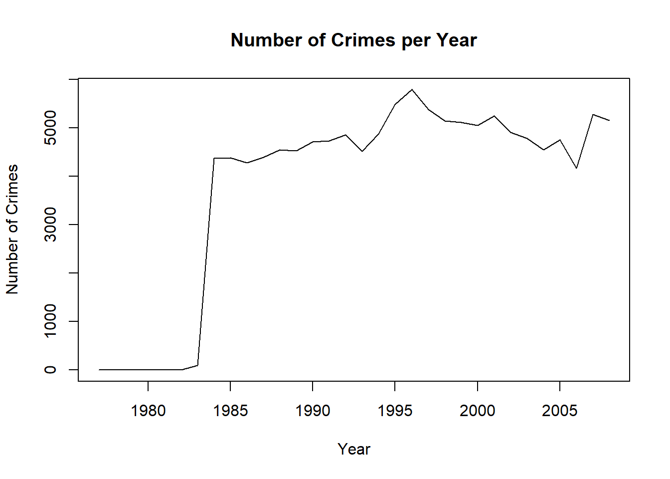

Slide 4
Dataset Overview
Data spans 10+ years (excluding pre-2000 for analysis clarity).
Key Columns:
Date, Time, Latitude & Longitude
Offense Category, Violent/Property Indicator
Domestic Indicator, Total Incidents
Dynamic data sourced from the National Incident-Based Reporting System (NIBRS).

Slide 5
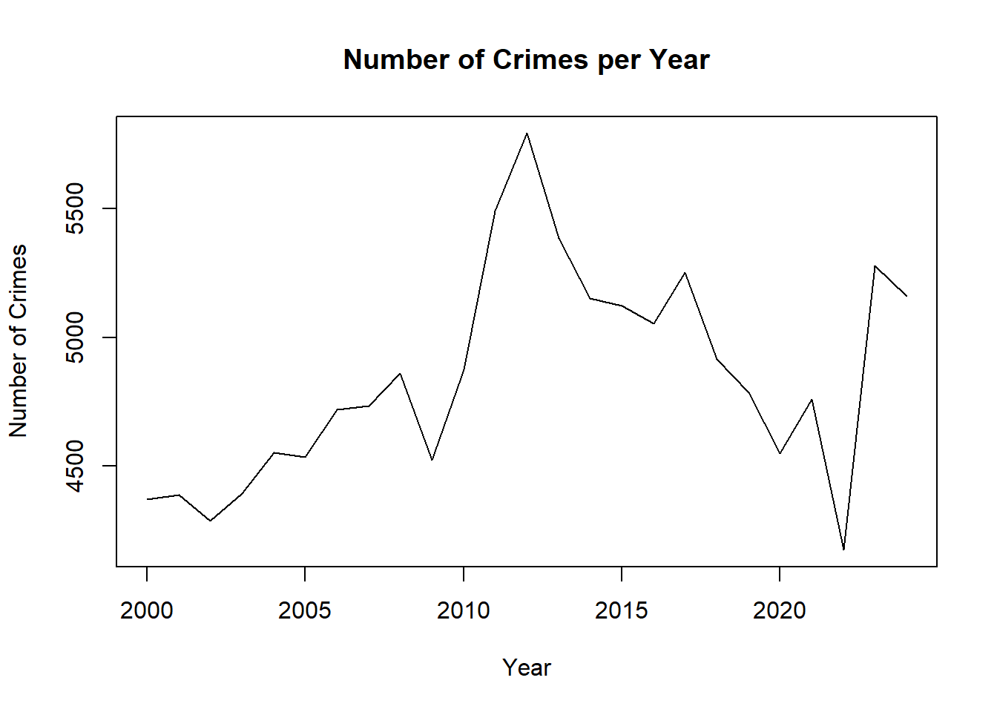

Slide 6
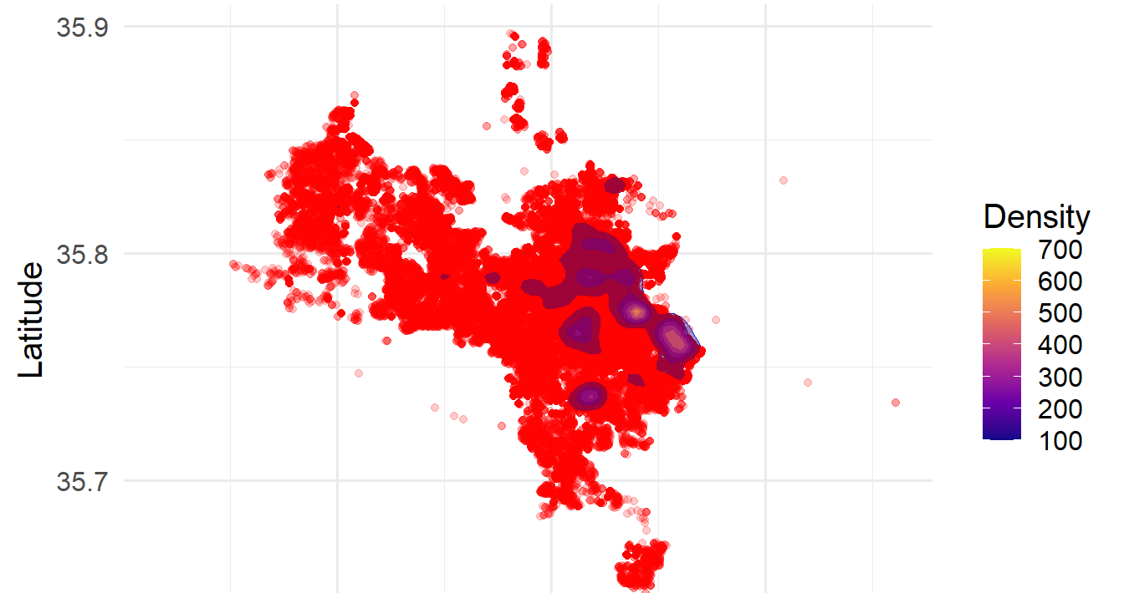
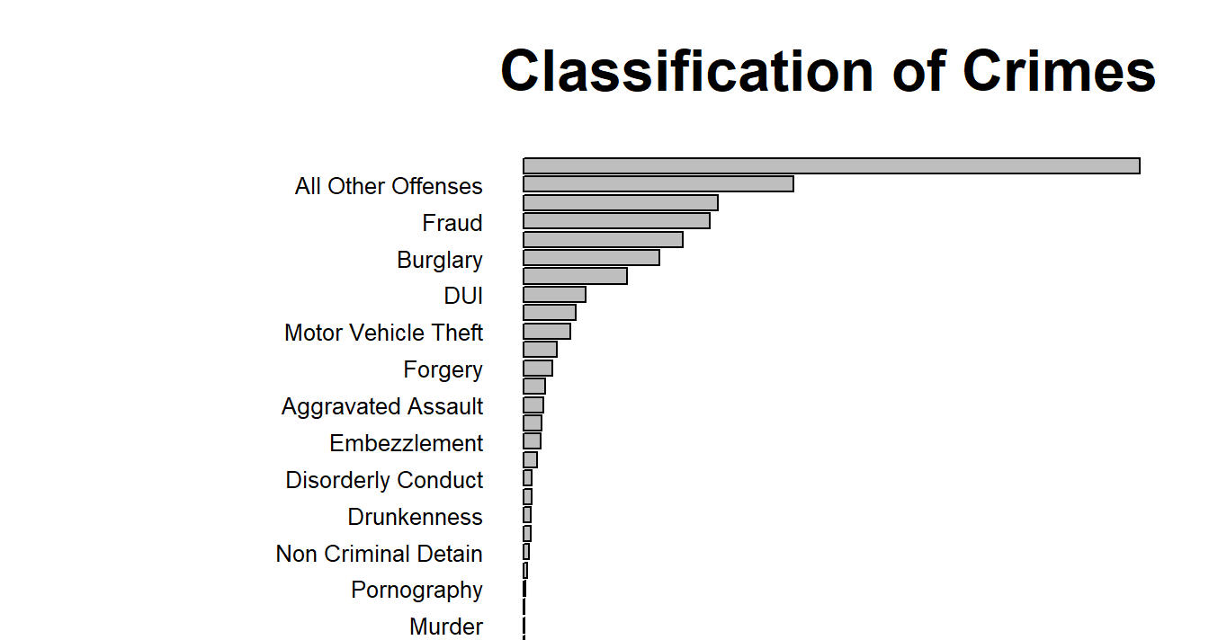
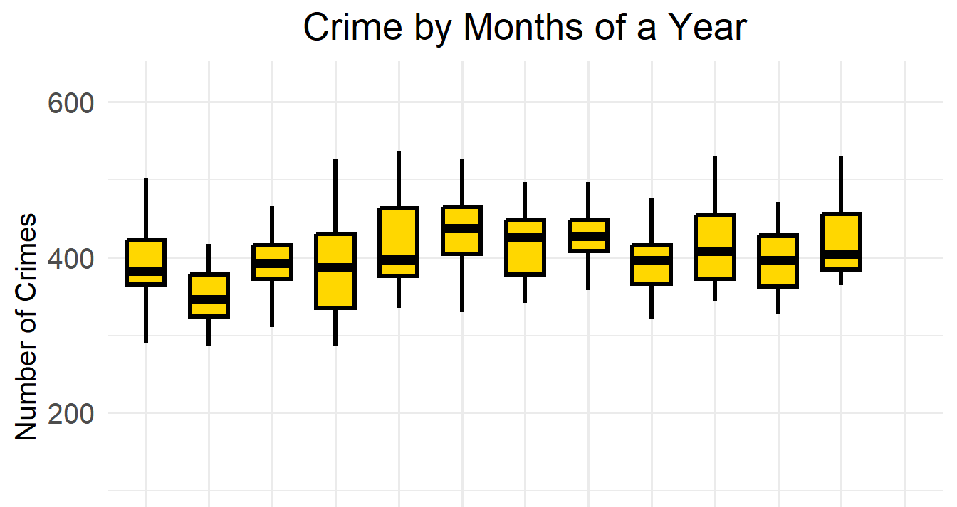
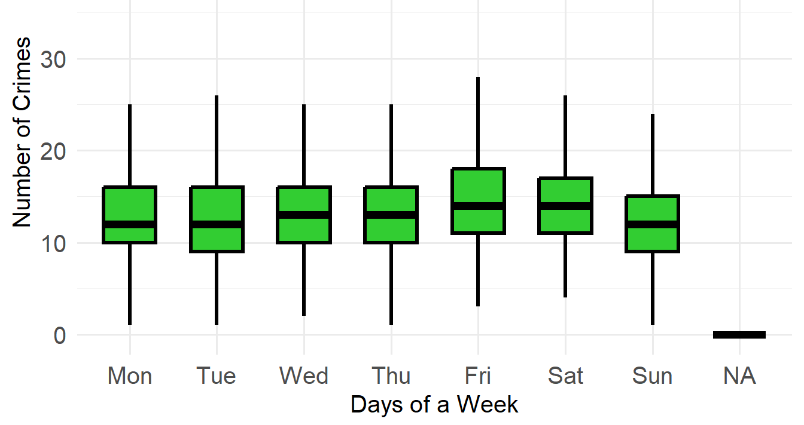
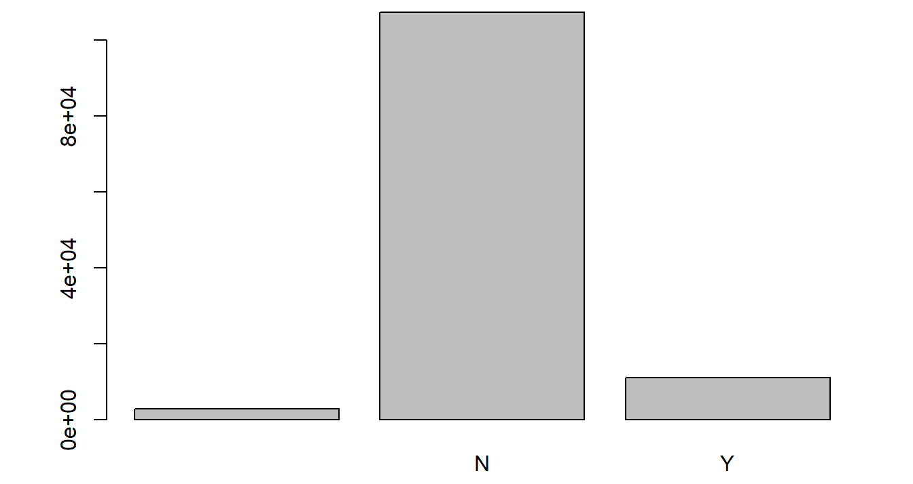
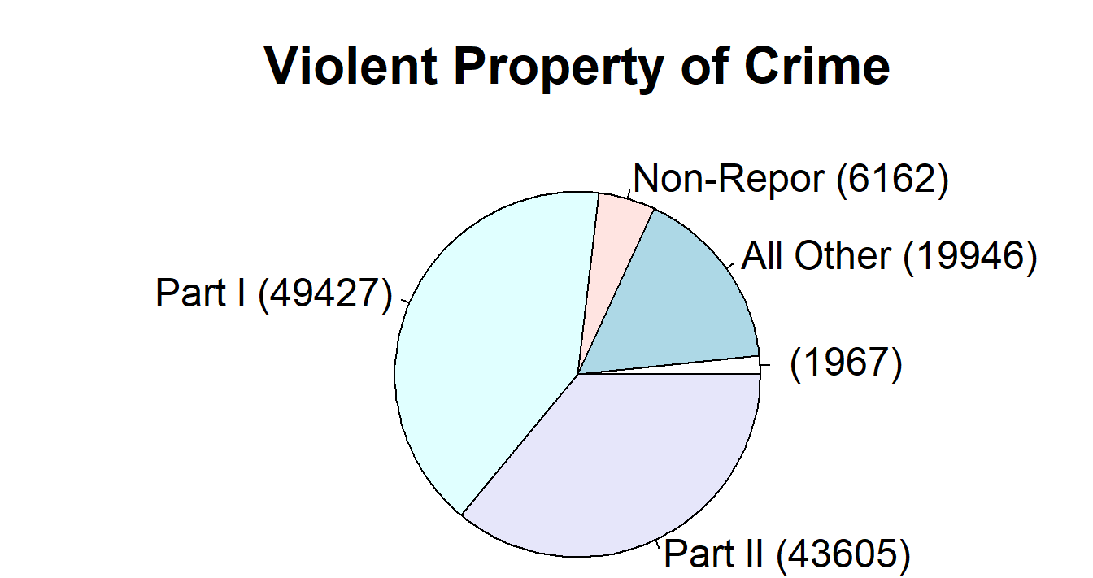
Exploratory Data Analysis (EDA)

Slide 7
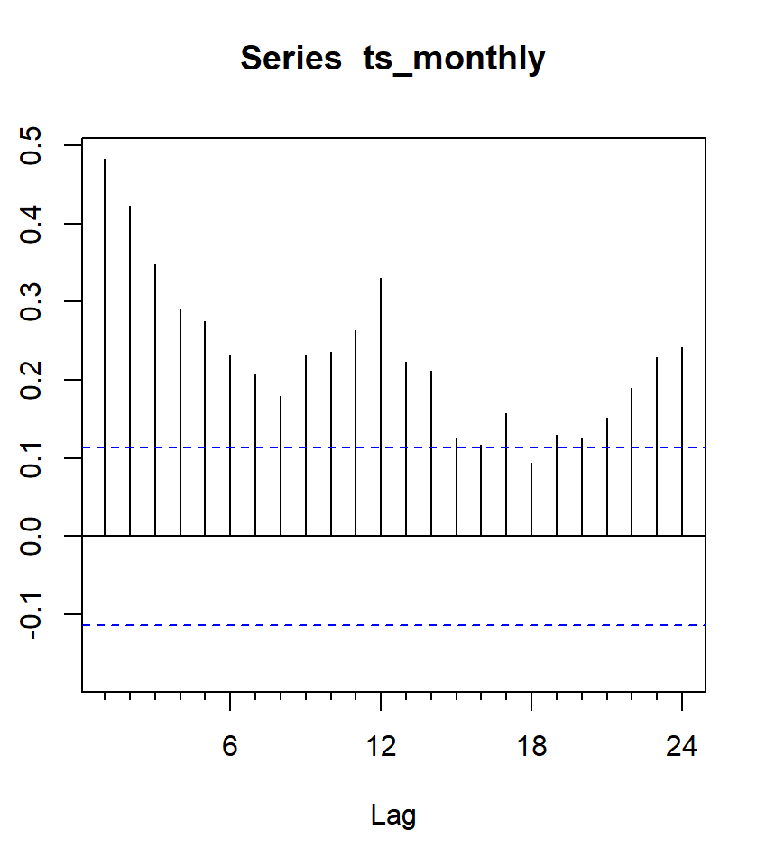
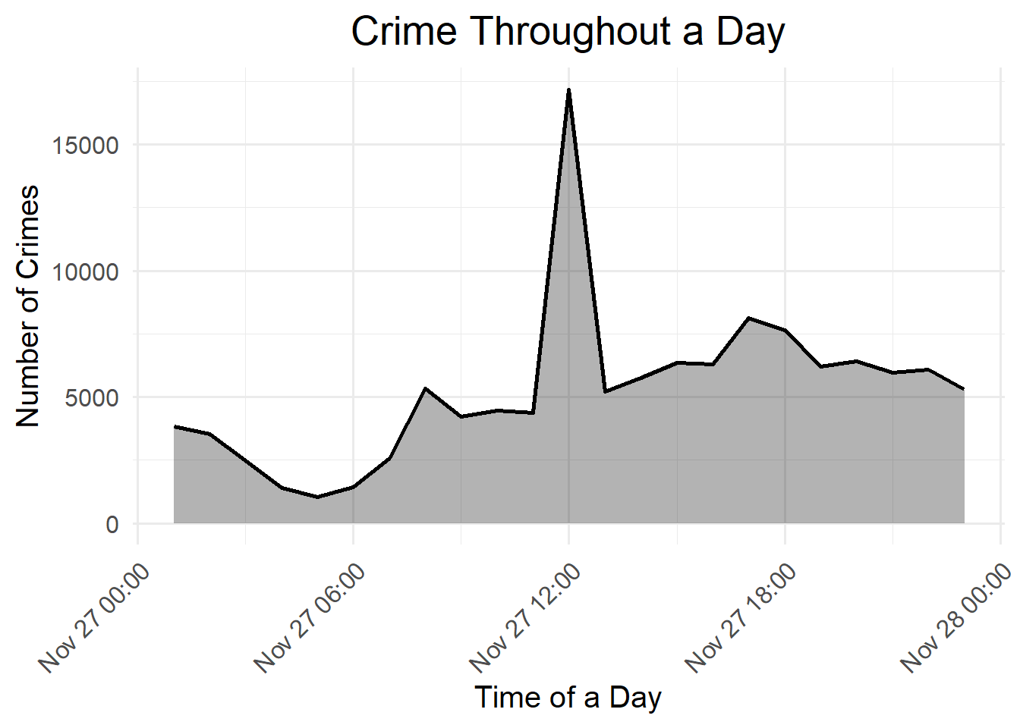
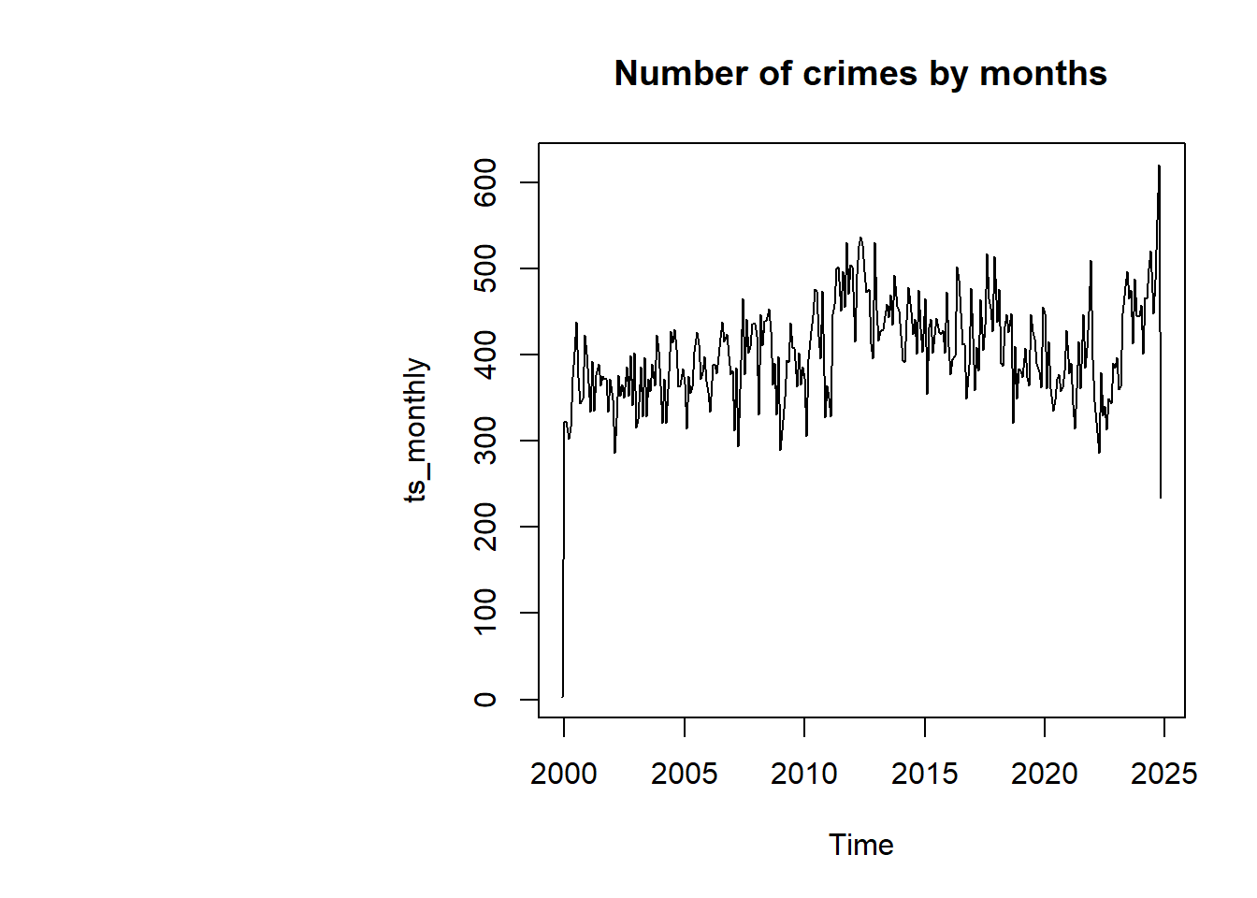
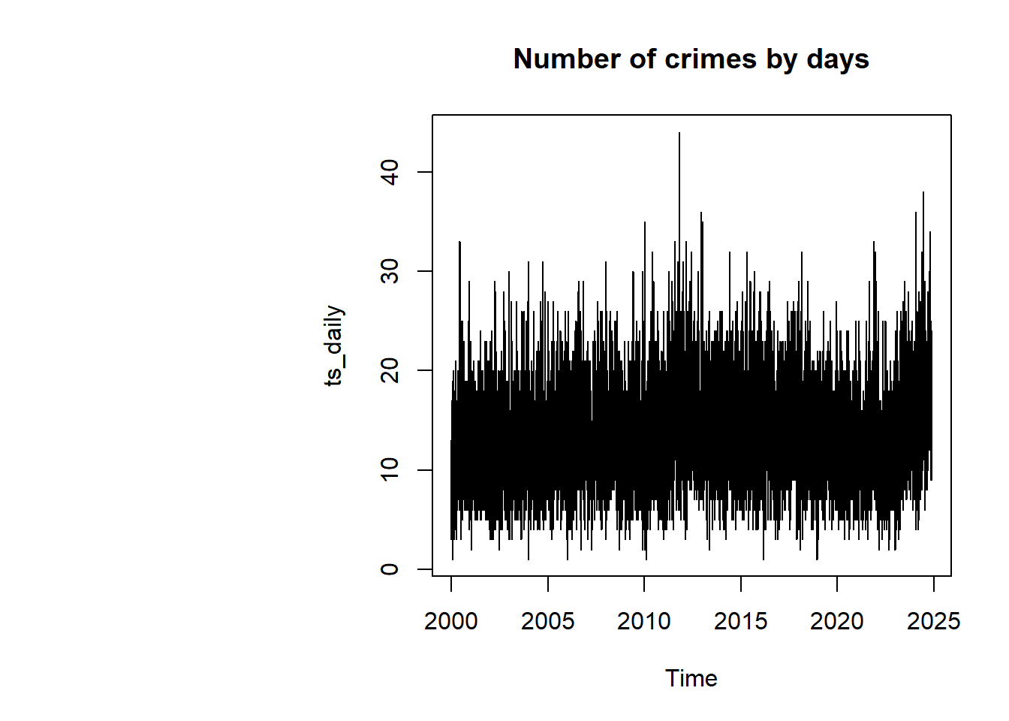
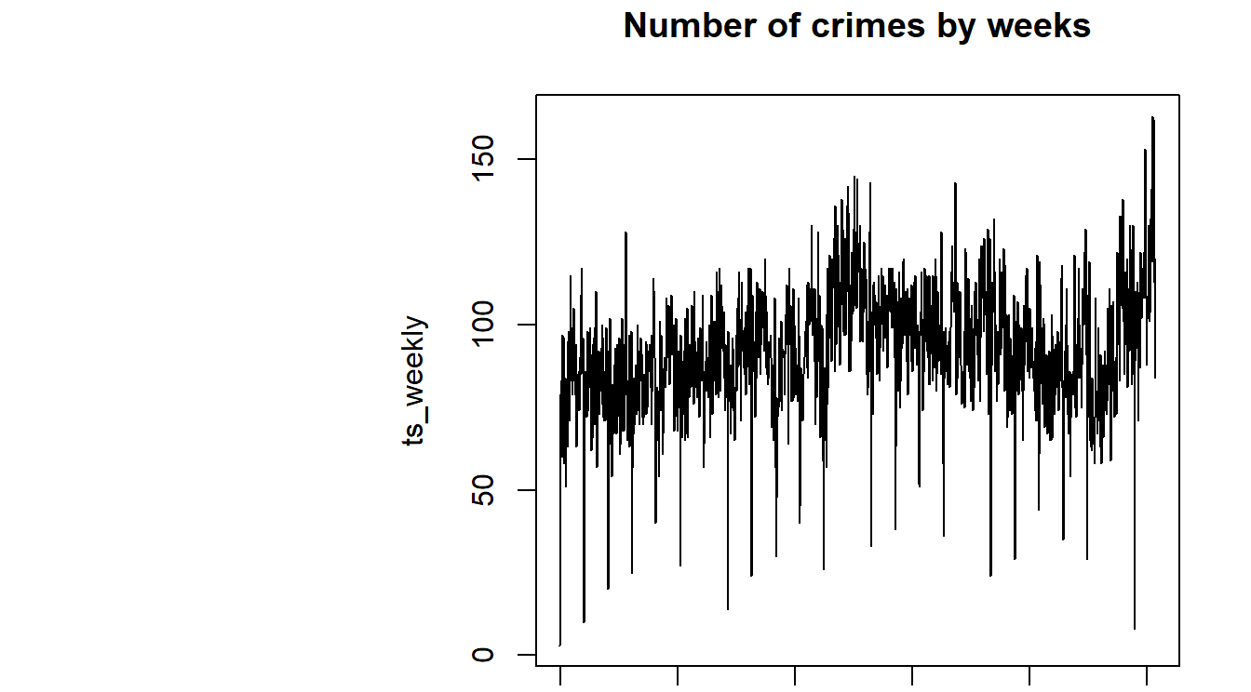
We would consider the monthly time-series for better predictability.
ACF indicates seasonality.

Slide 8
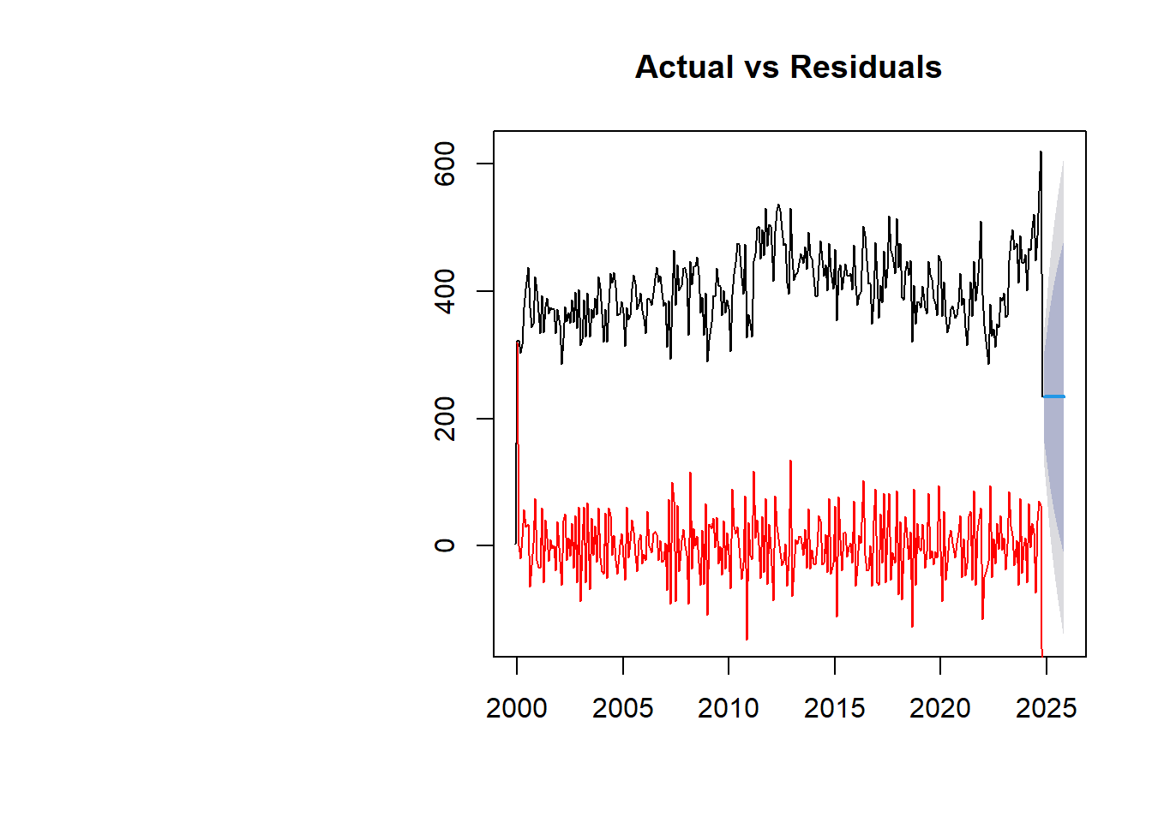
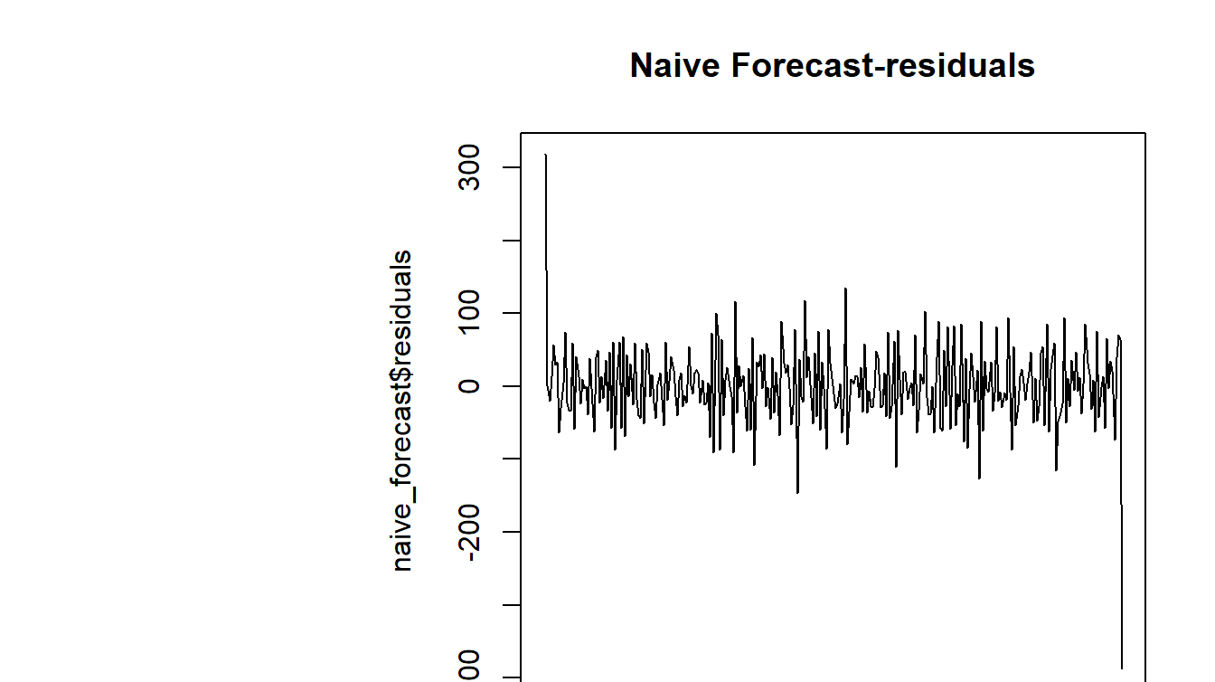
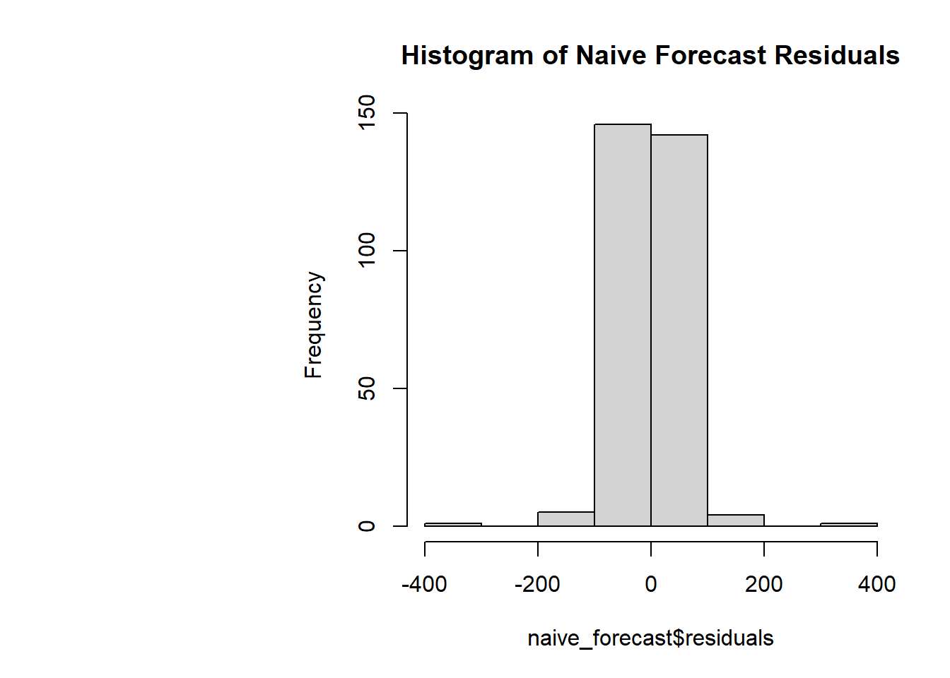
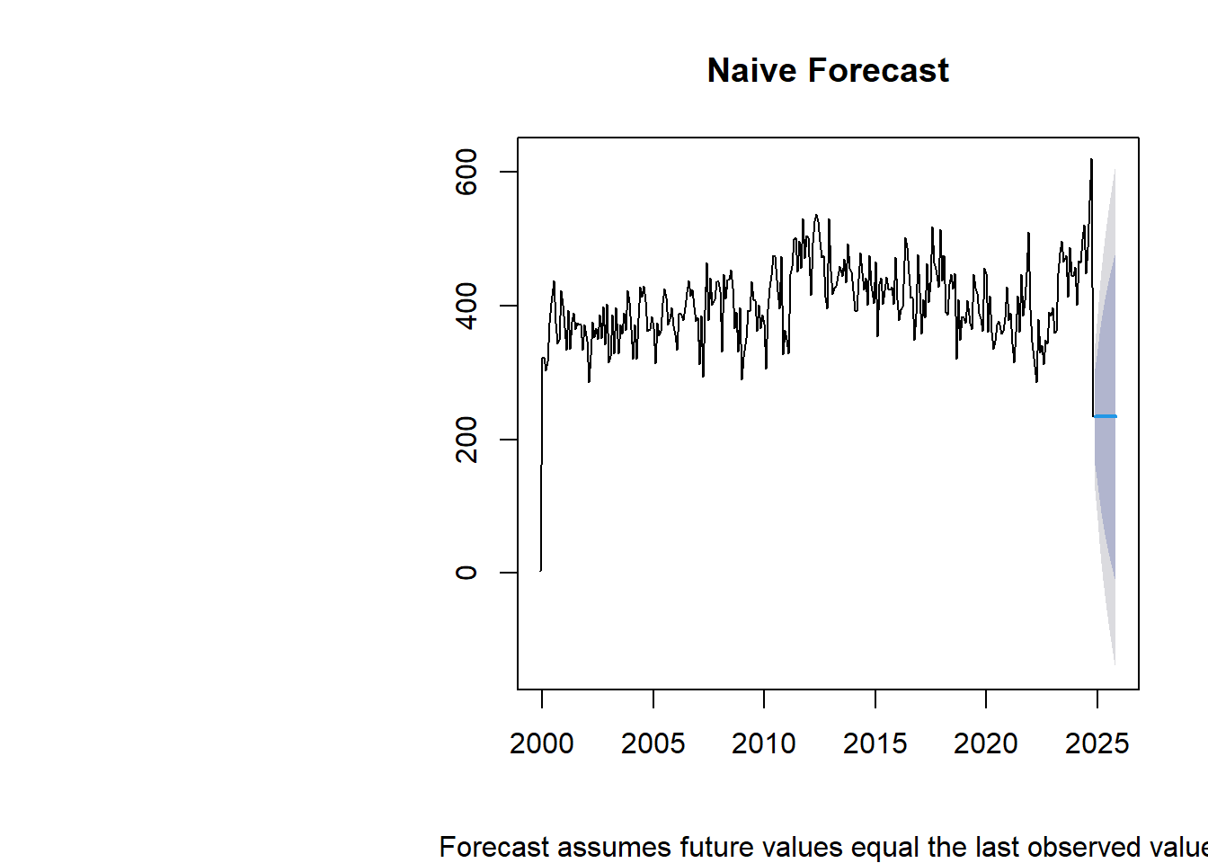
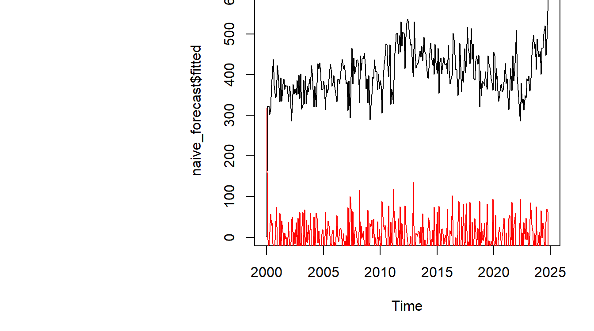
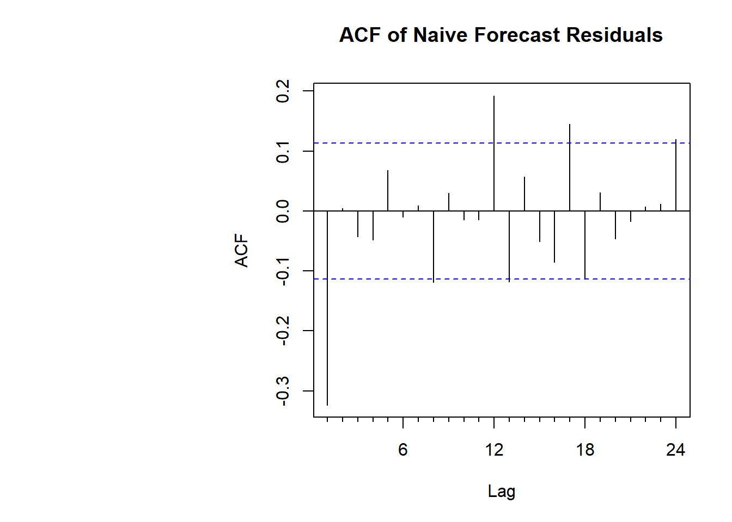
Naïve Forecast
Assumes future values equal the last observed value.
The residuals are randomly distributed, shows no pattern.
This means that the Naive forecast is being able to capture the seasonality and trend.
Since the histogram is normal, it means that the Naive Forecast might be a good method in this case.

Slide 9
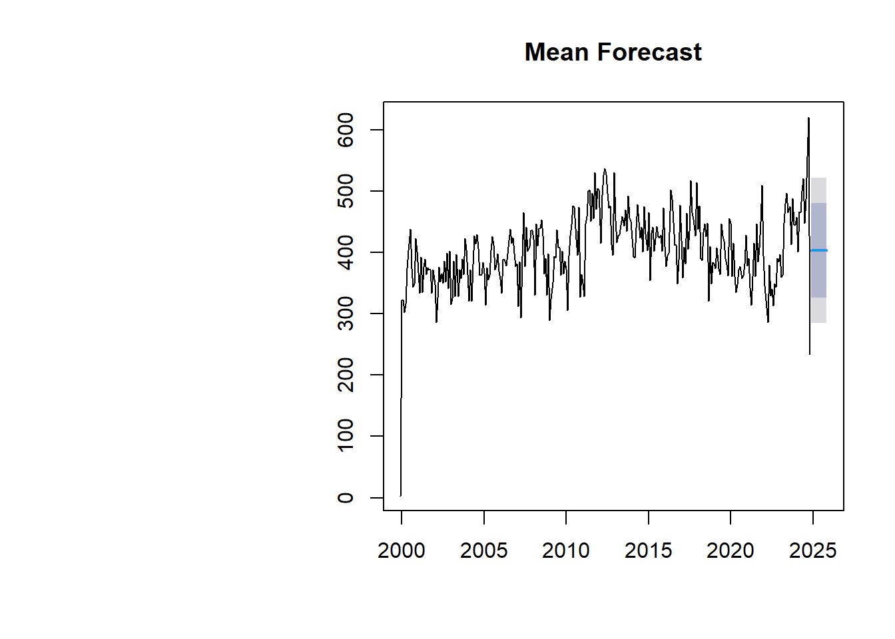
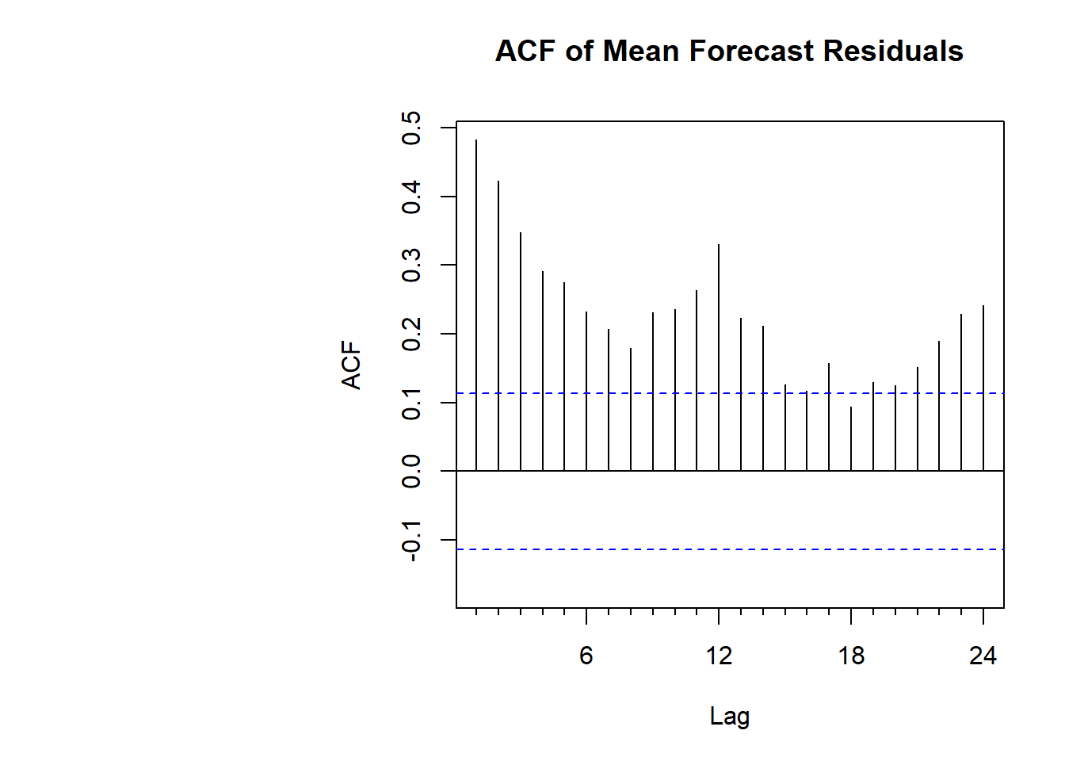
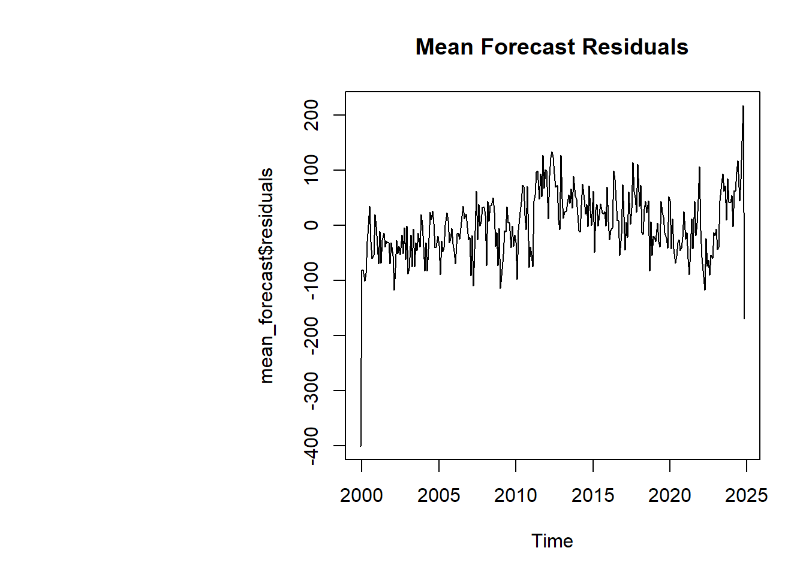
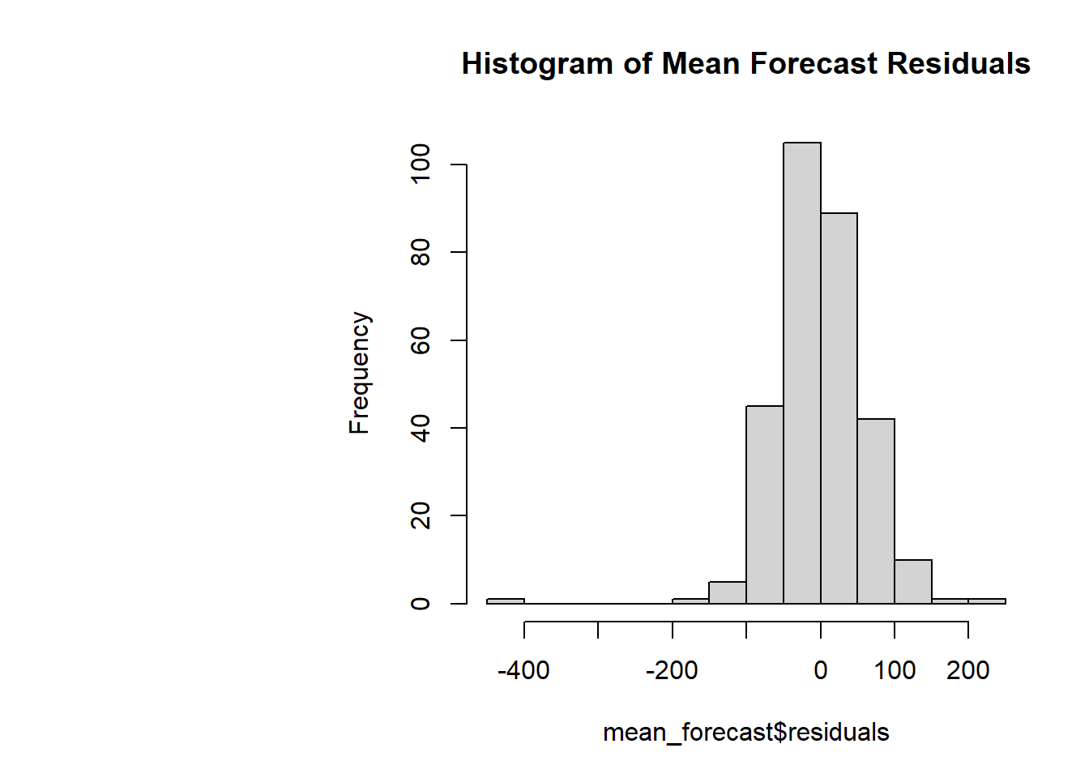
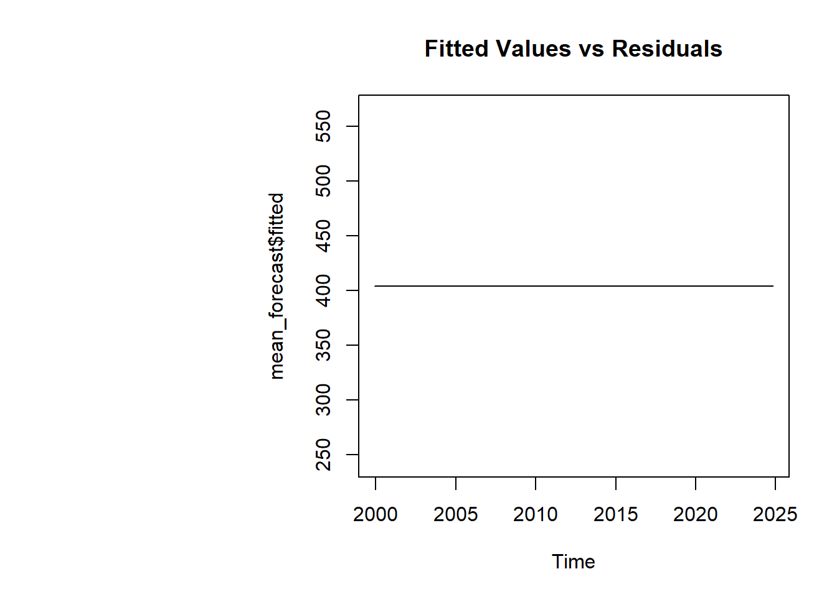
Mean Forecast
Assumes future values equal the mean of past values.
Observing the residuals, we can say the Mean Forecast does not effectively capture the pattern.
Since the existence of patterns in residuals, it suggests the model’s limitations.

Slide 10
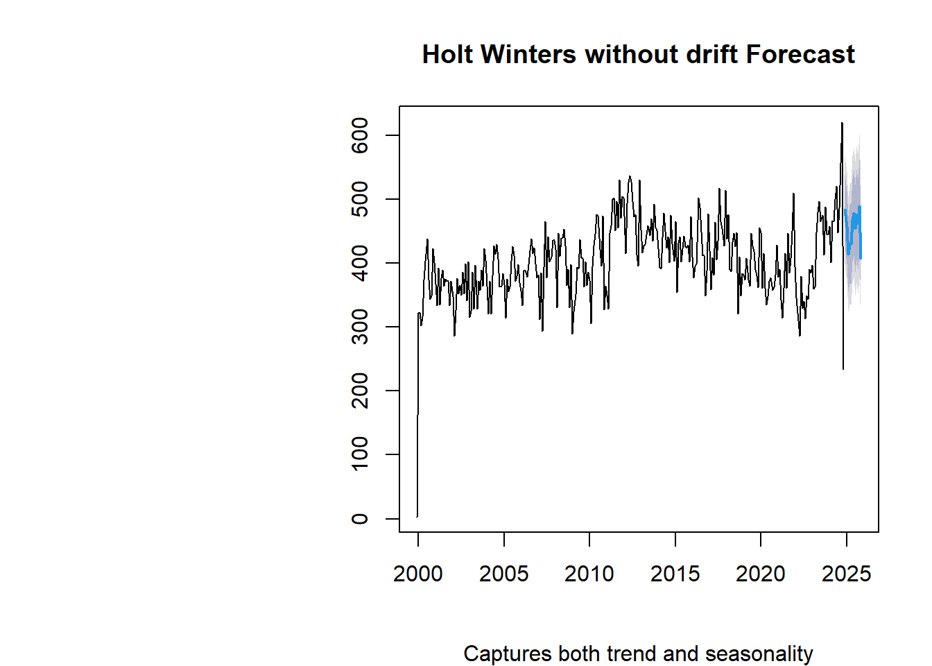
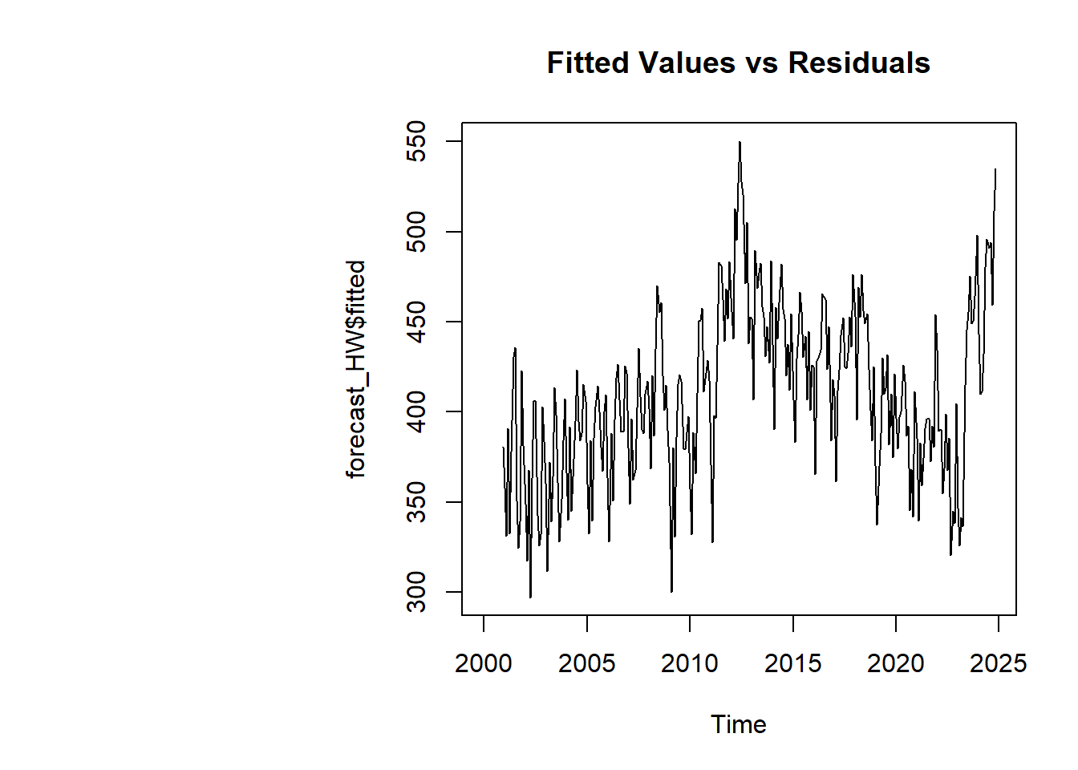
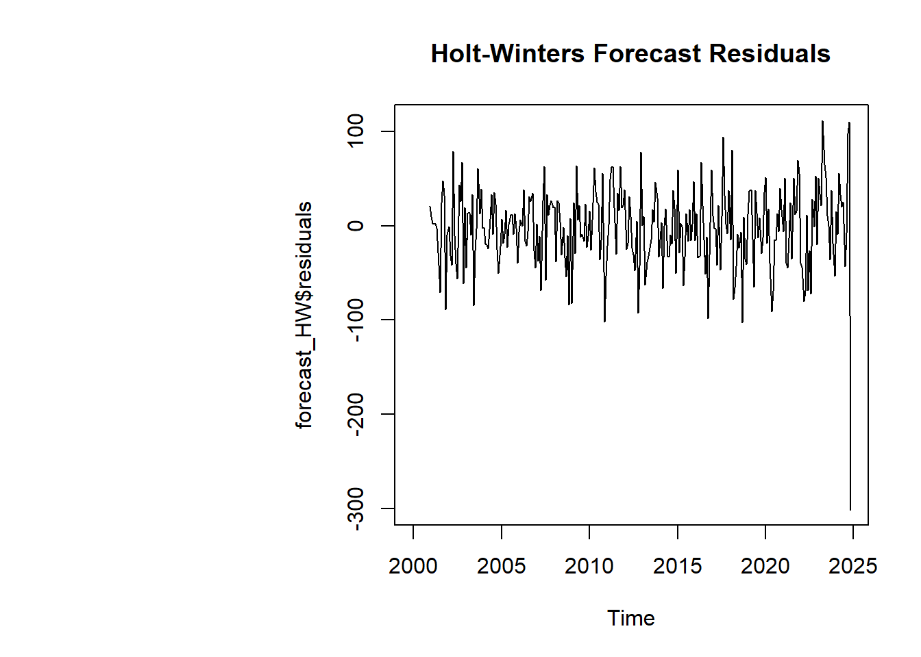
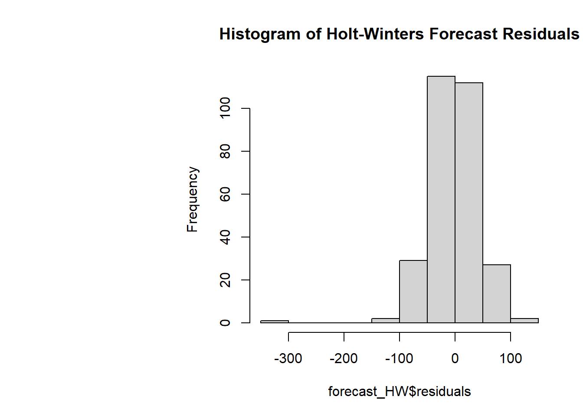
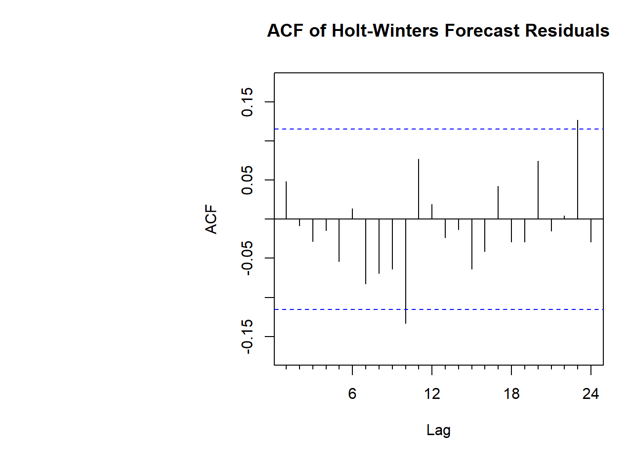
Holt Winters Forecast
The Holt Winters Forecast captures both trend and seasonality

Slide 11
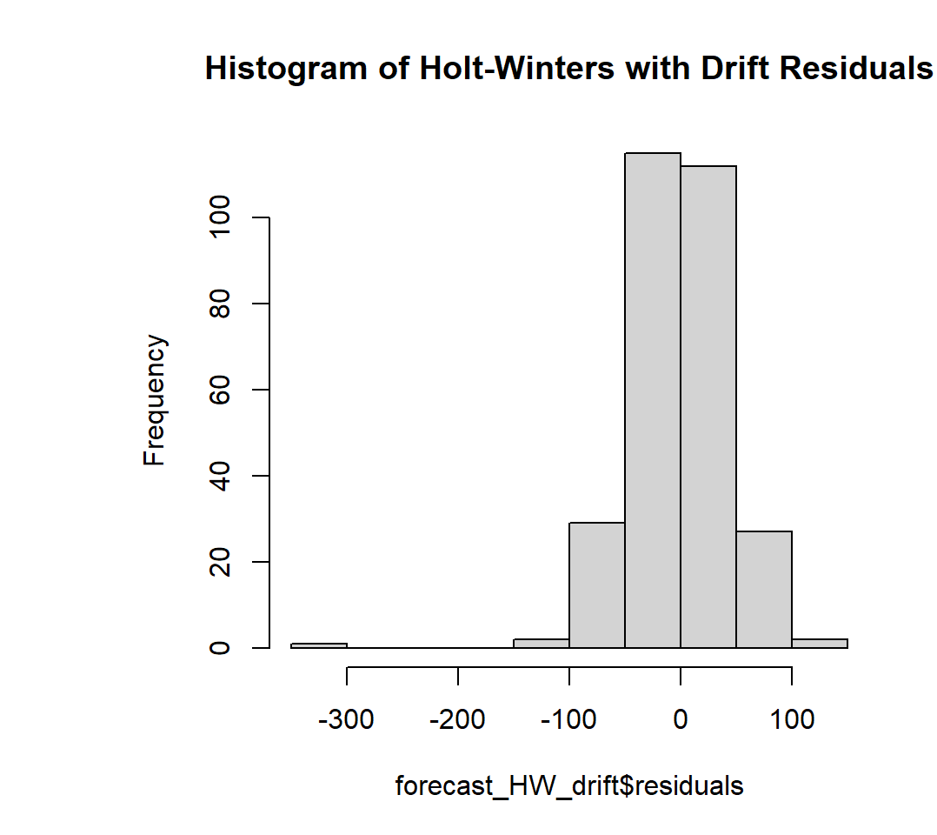
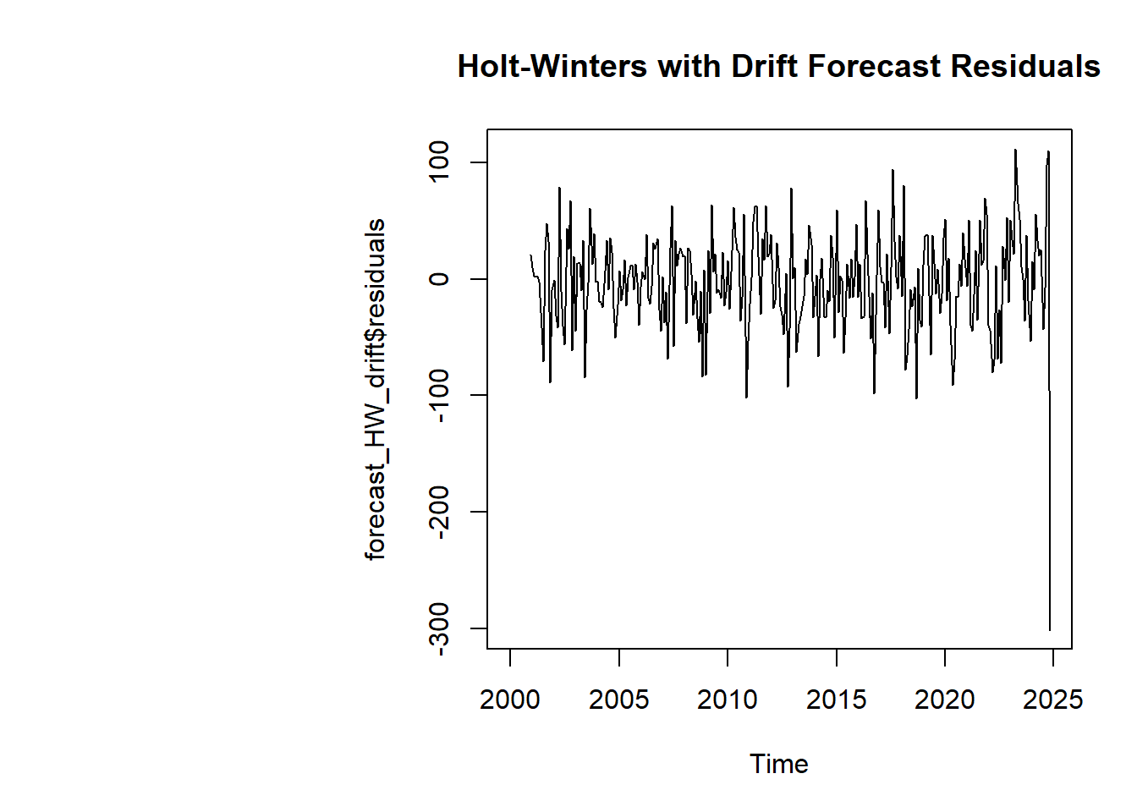


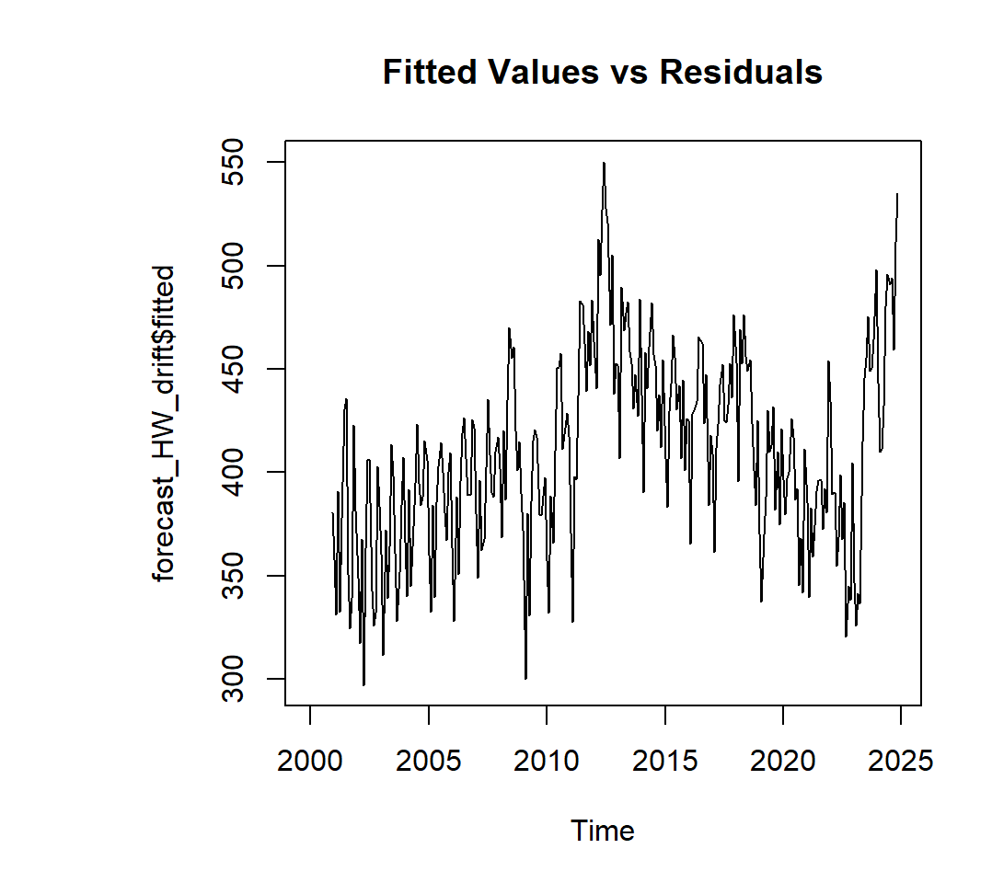
Holt Winters with drift
Since both the models of Holt-Winters do not show patterns in its residuals, this suggests that the model is capturing the seasonality or trend.

Slide 12
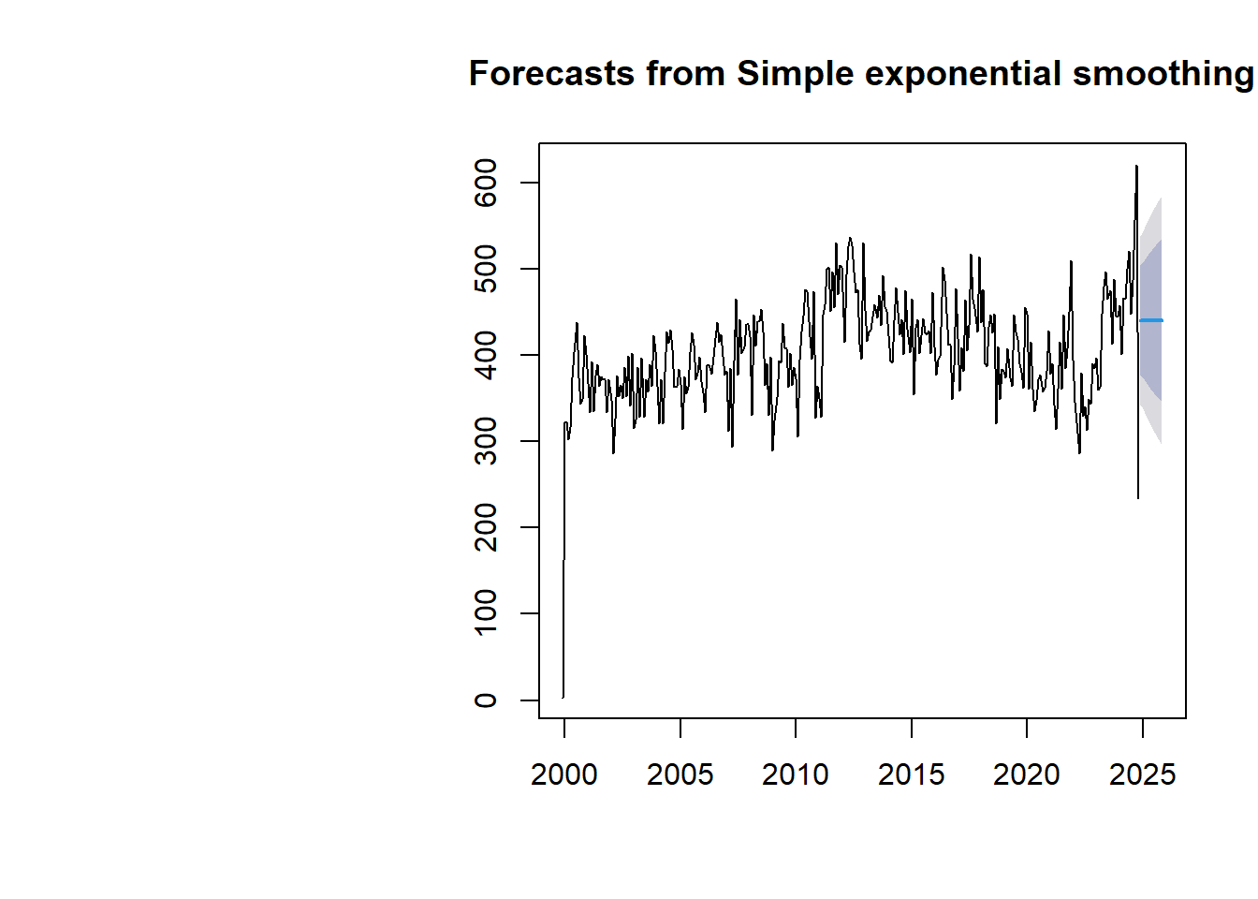
Simple Exponential Smoothing Forecast
SES can be effective because it uses a weighted average of past values, putting more weight on recent observations without explicitly modeling trend or seasonality.

Slide 13
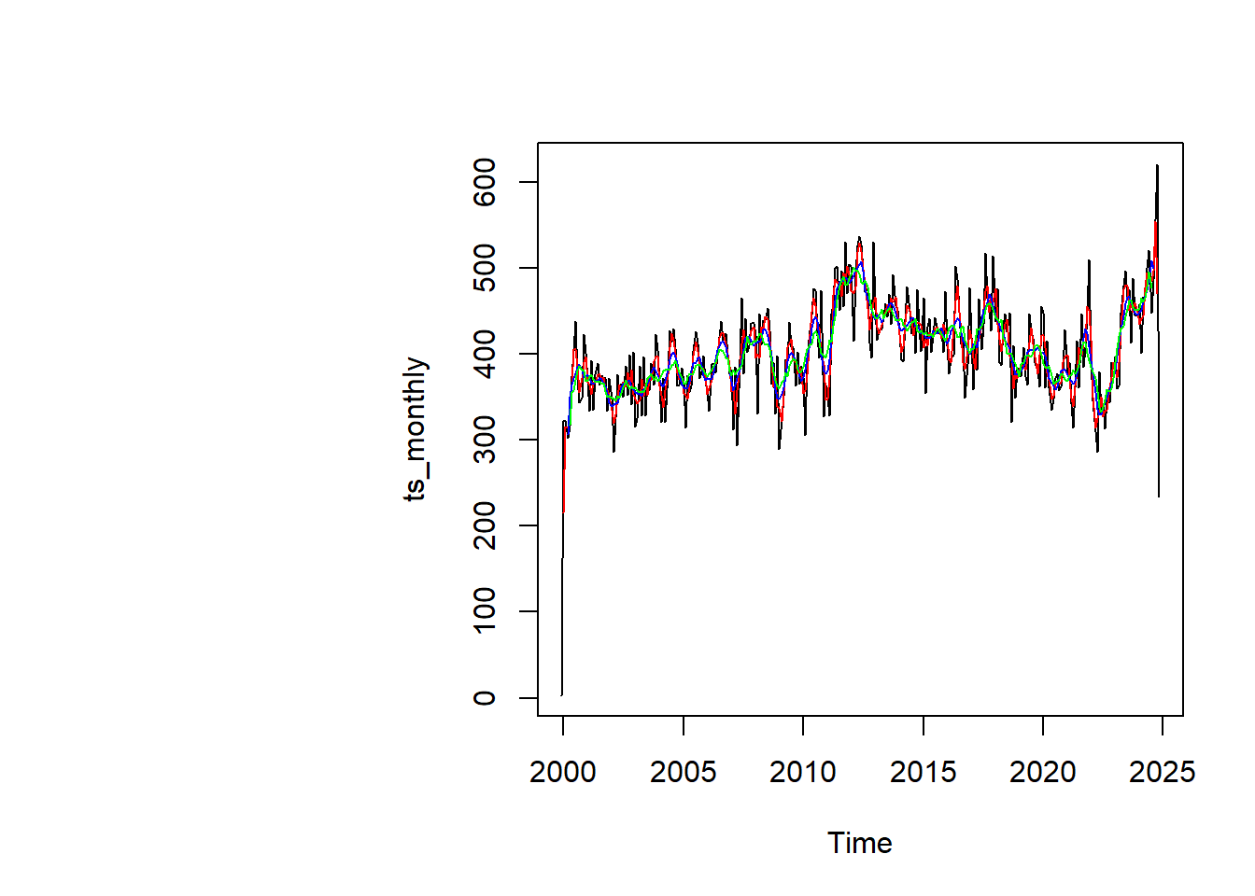
Moving averages
Moving averages with order 3,6,9.
The moving average is similar to the mean forecast, only difference here is that the averages are a sliding window of the order mentiones.
The moving average with an order 3 in this case seems to be a good fit

Slide 14
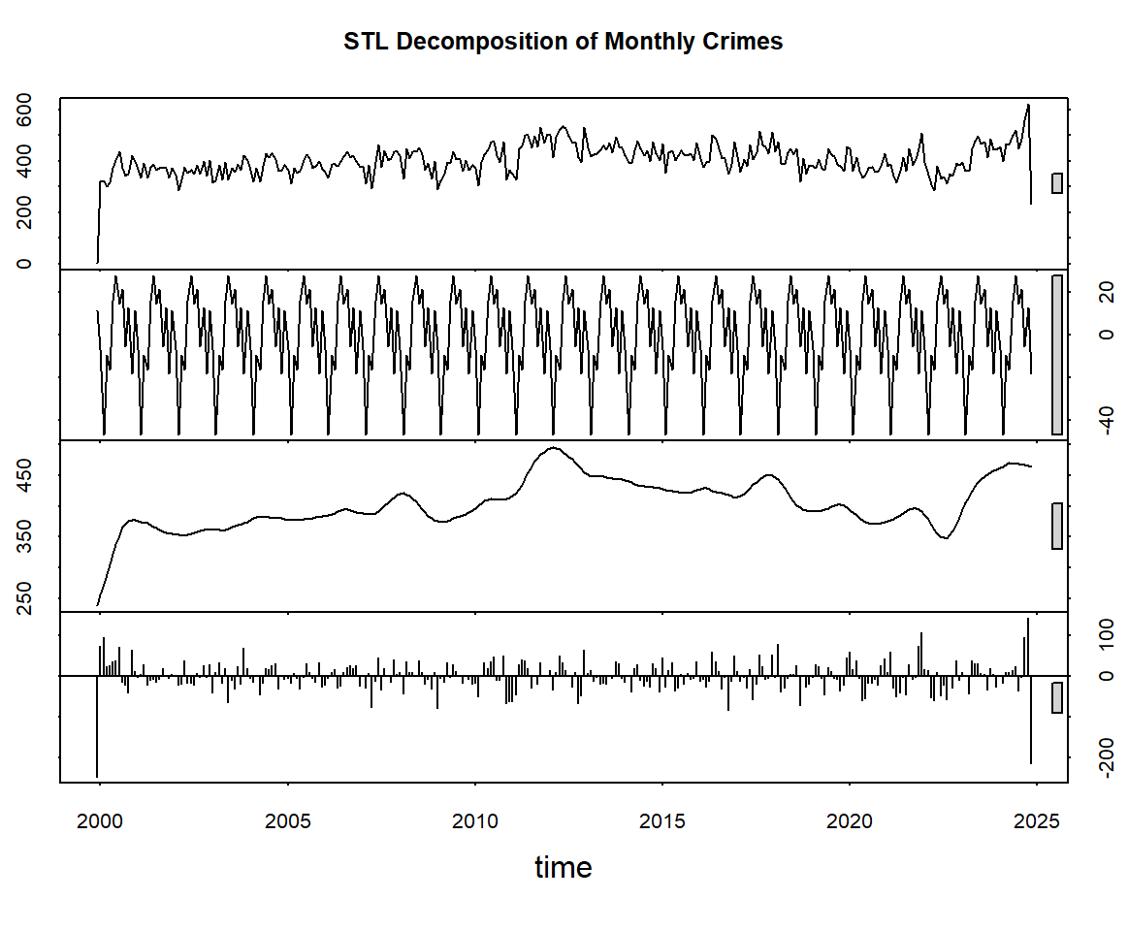
STL Decompostion

Slide 15
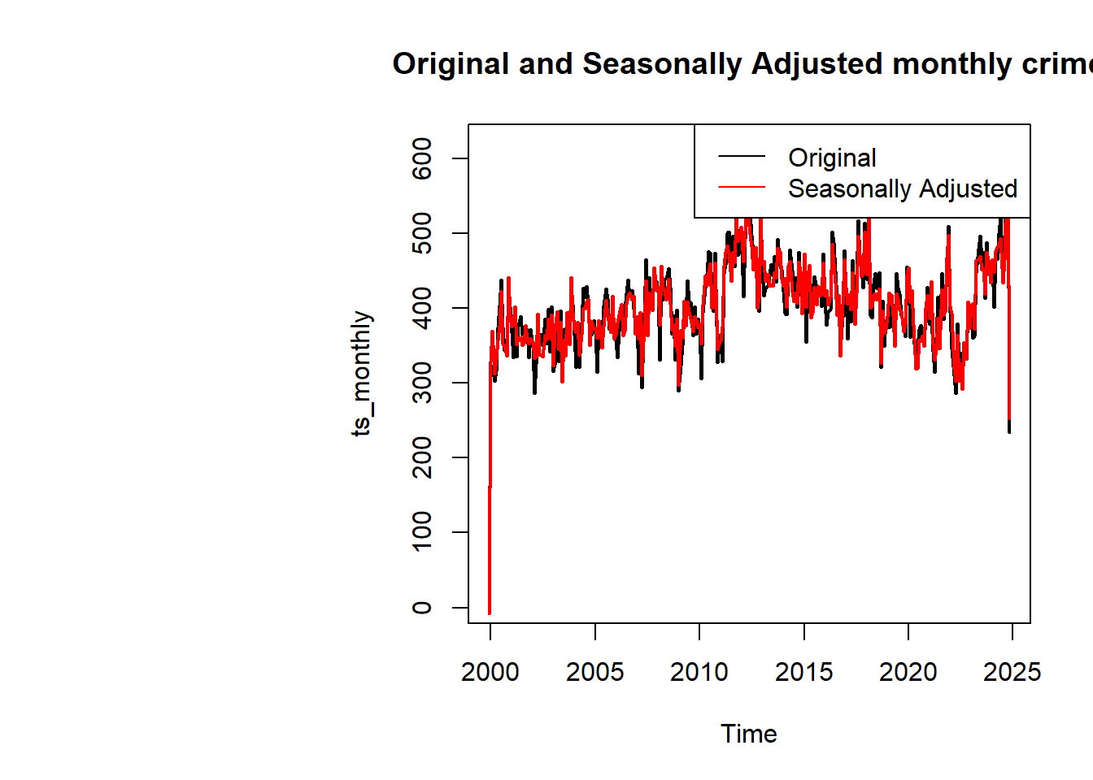
Since there is a significant overlap between the original timeseries and seasonally independent timeseries, seasonality is not very pronounced.
Factors like trend or randomness might have bigger influence on the data.

Slide 16
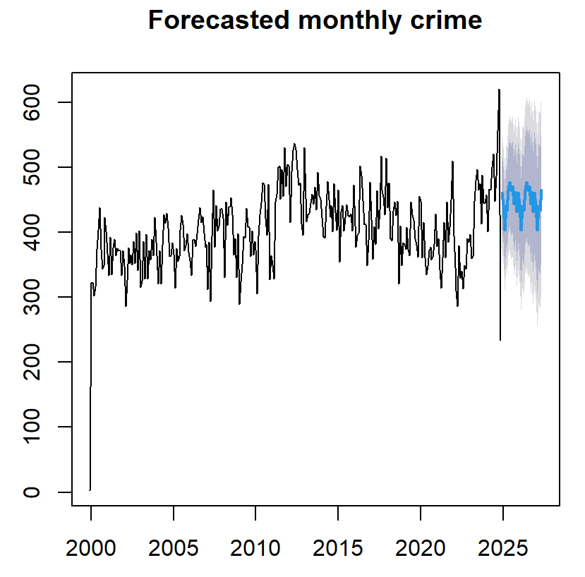
STL Forecasting

Slide 17
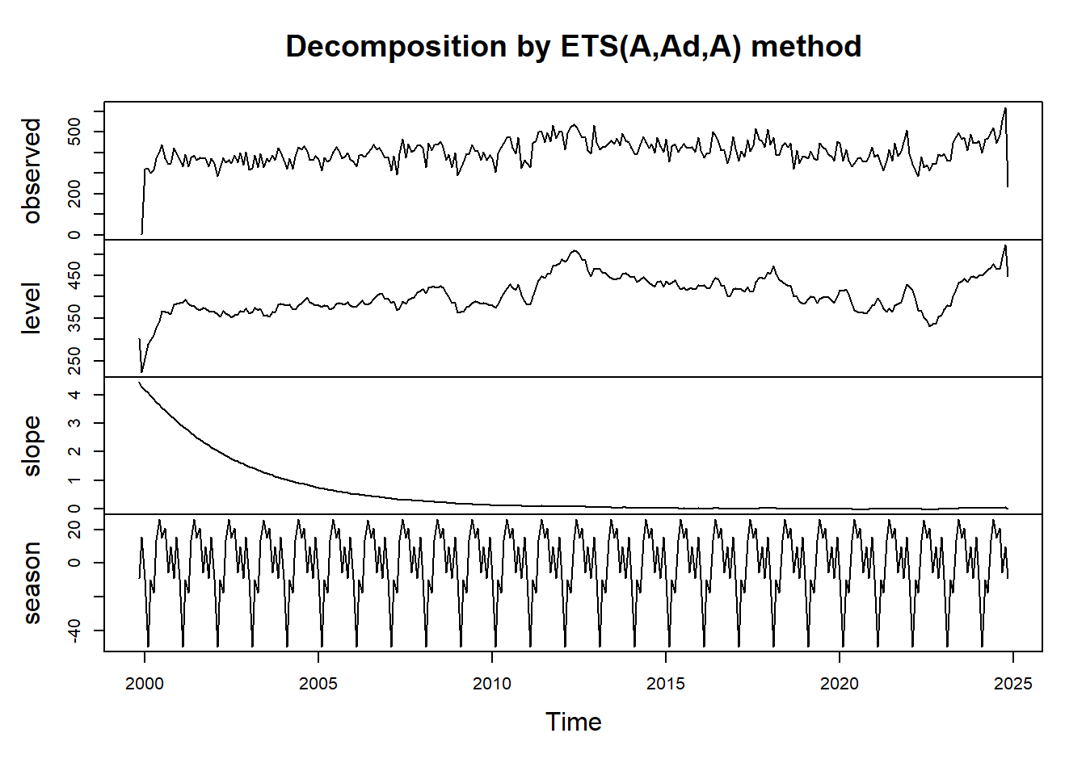
ETS Decompostion

Slide 18
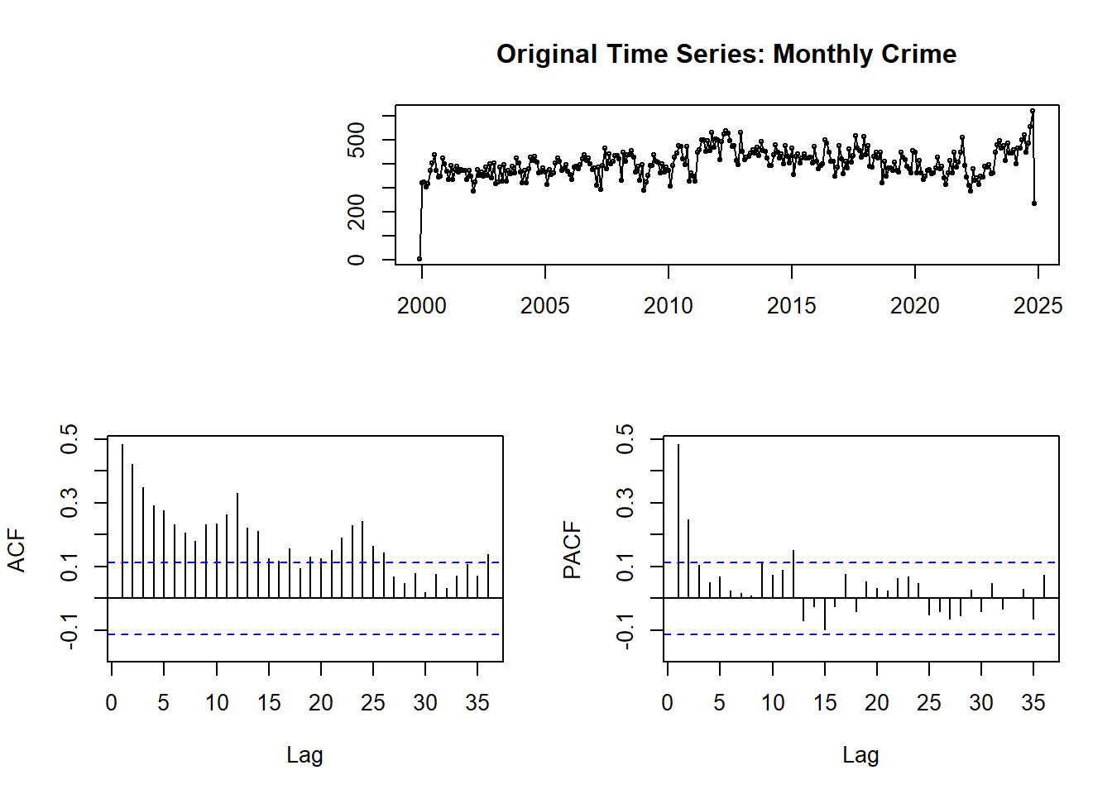
ARIMA
Making data stationary is essential for ARIMA because the model assumes consistent statistical properties (mean, variance, and autocorrelation) over time. Stationarity simplifies analysis by removing trends and seasonality, ensuring reliable parameter estimation and accurate forecasting.
Without stationarity, ARIMA may produce spurious results. Techniques like differencing, log transformations, and detrending are commonly used to achieve stationarity, enabling the model to focus on underlying patterns and make robust predictions.

Slide 19
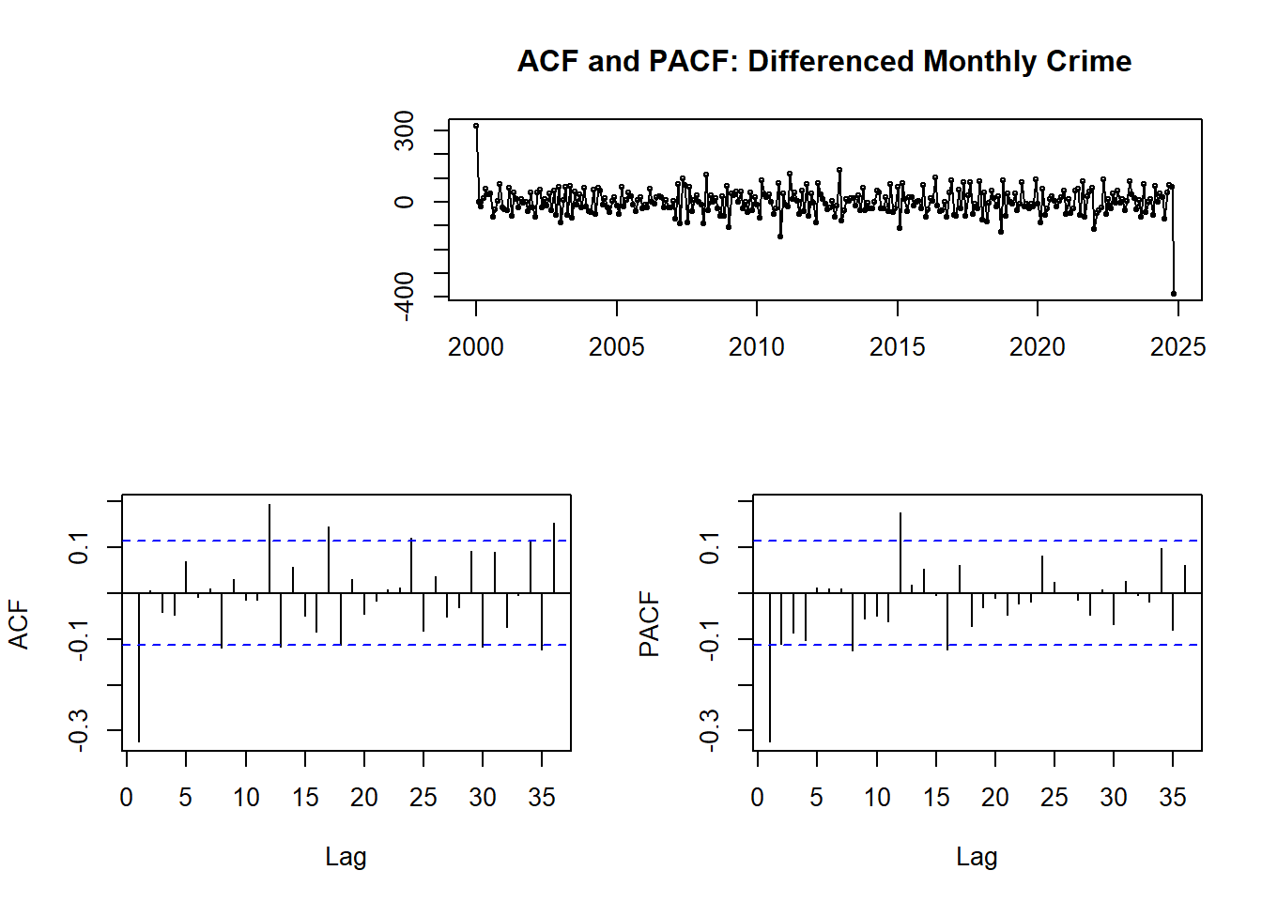

Slide 20
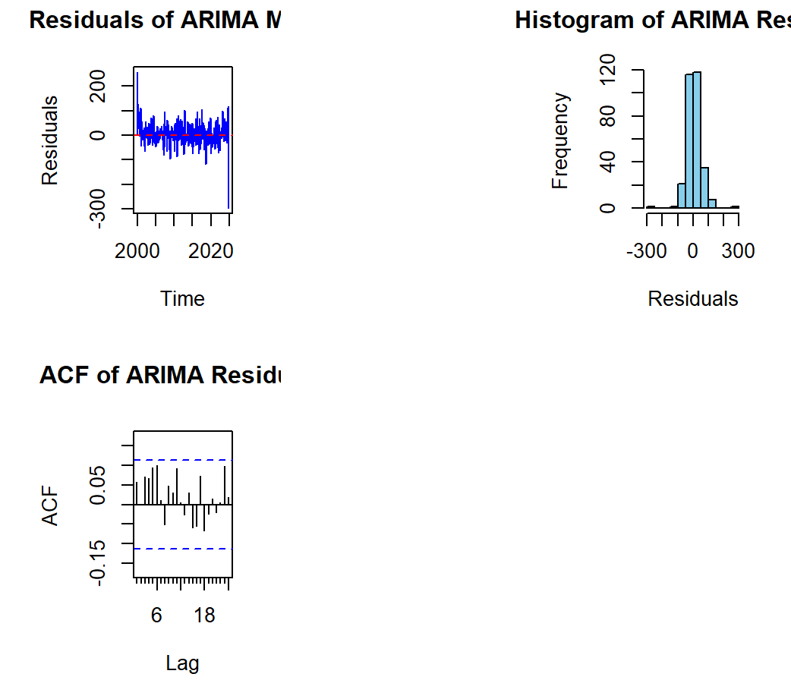
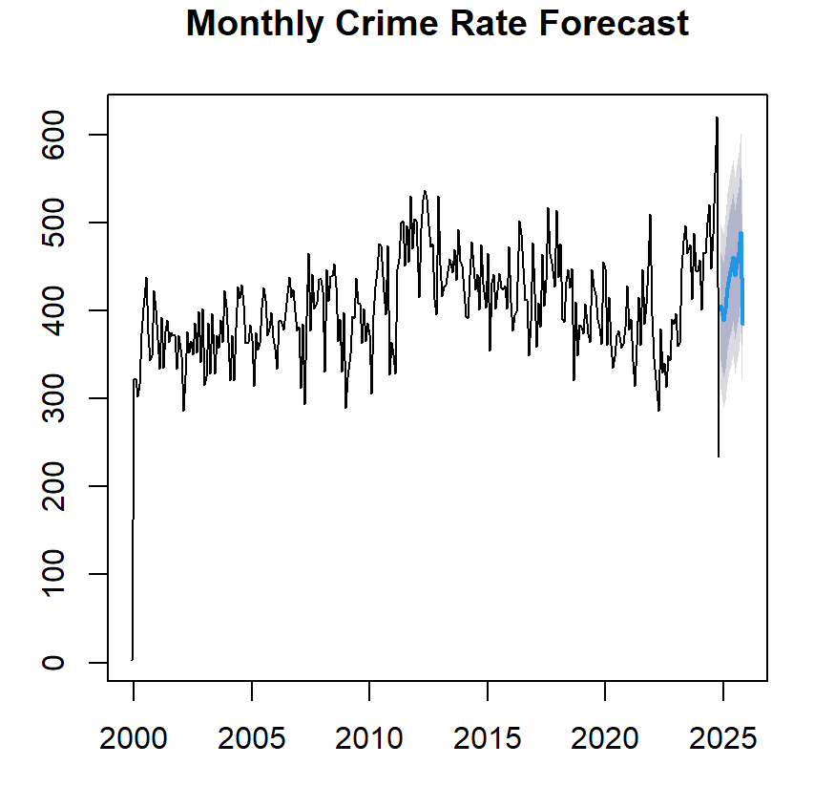

Slide 21
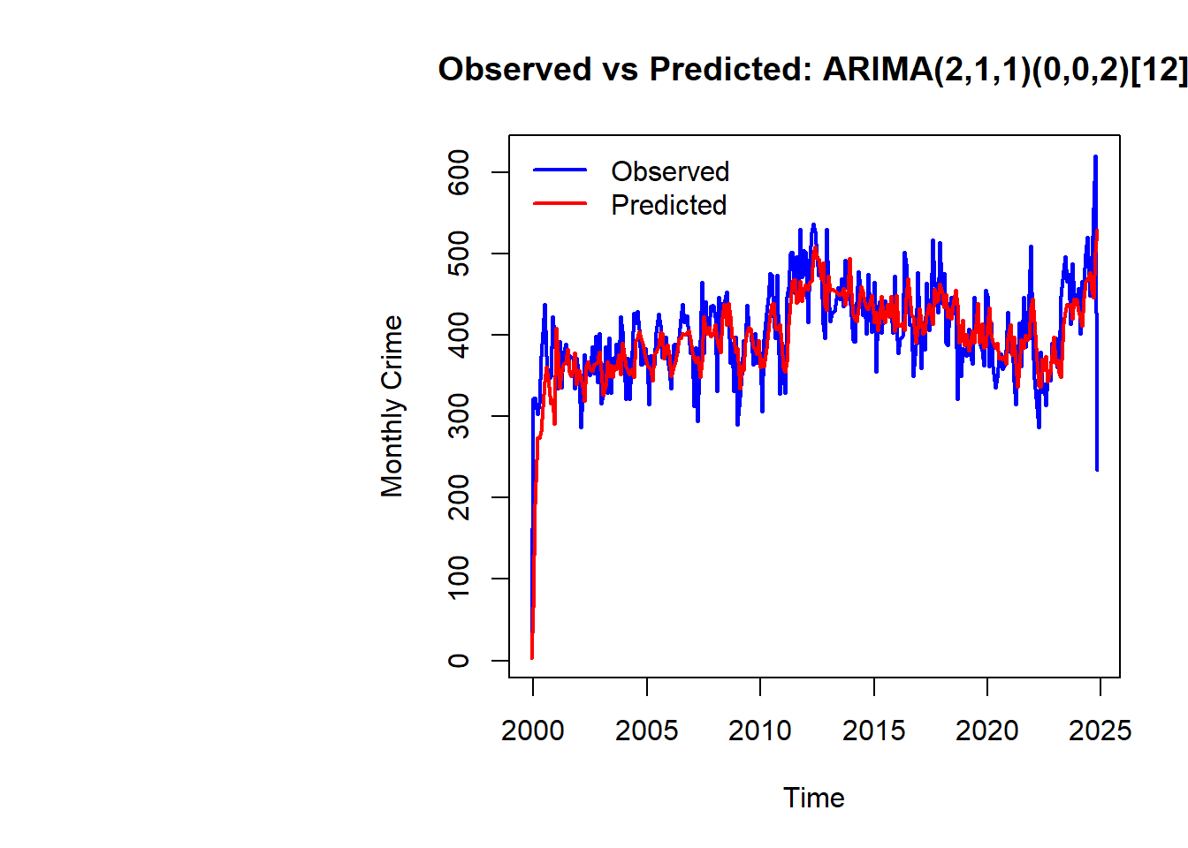
The ARIMA(2,1,1)(0,0,2)[12] model indicates a seasonal ARIMA with two autoregressive terms (AR), one differencing step (I), and one moving average term (MA), alongside two seasonal moving average terms (sMA) for monthly data.
The coefficients provide weights for these components, with associated standard errors indicating the uncertainty of each estimate. Key model evaluation metrics include AIC (3170.87), AICc (3171.16), and BIC (3193.08), where lower values indicate better fit while penalizing complexity.
Training set error measures such as RMSE (47.39) and MAE (34.60) highlight the average prediction errors. MAPE (8.85%) reflects a reasonably accurate model, with residuals showing minimal autocorrelation (ACF1 = 0.056), suggesting a good fit for the data with little remaining structure in the errors.

Slide 22
Overall, the forecast suggests a slight decline in crime rates in the near future, followed by minor fluctuations. The trend indicates that crime levels are likely to stabilize and remain close to the current levels by the end of the year.
The RMSE values from different forecasting methods highlight their predictive accuracy for the given time series data. Among the methods, the Moving Average with a window size of 3 (MA3) achieves the lowest RMSE (28.70), suggesting it provides the most accurate forecasts. The Holt-Winters (HW) method also performs well (RMSE: 42.97), capturing trends and seasonality effectively.
In contrast, the Naive method has the highest RMSE (55.76), indicating less reliable predictions. These results emphasize the importance of selecting the most suitable method, like MA3, for forecasting in this context.

Slide 23
Individual Crime Forecast
A comprehensive analysis of residuals had been performed for each forecasting model, for each crime category. This would help in analyzing the specific crime that needs to be paid more attention, the areas where the law enforcement is doing well.
Only a few categories are listed here for space constraints, complete analysis is given in the html or rmd file.

Slide 24
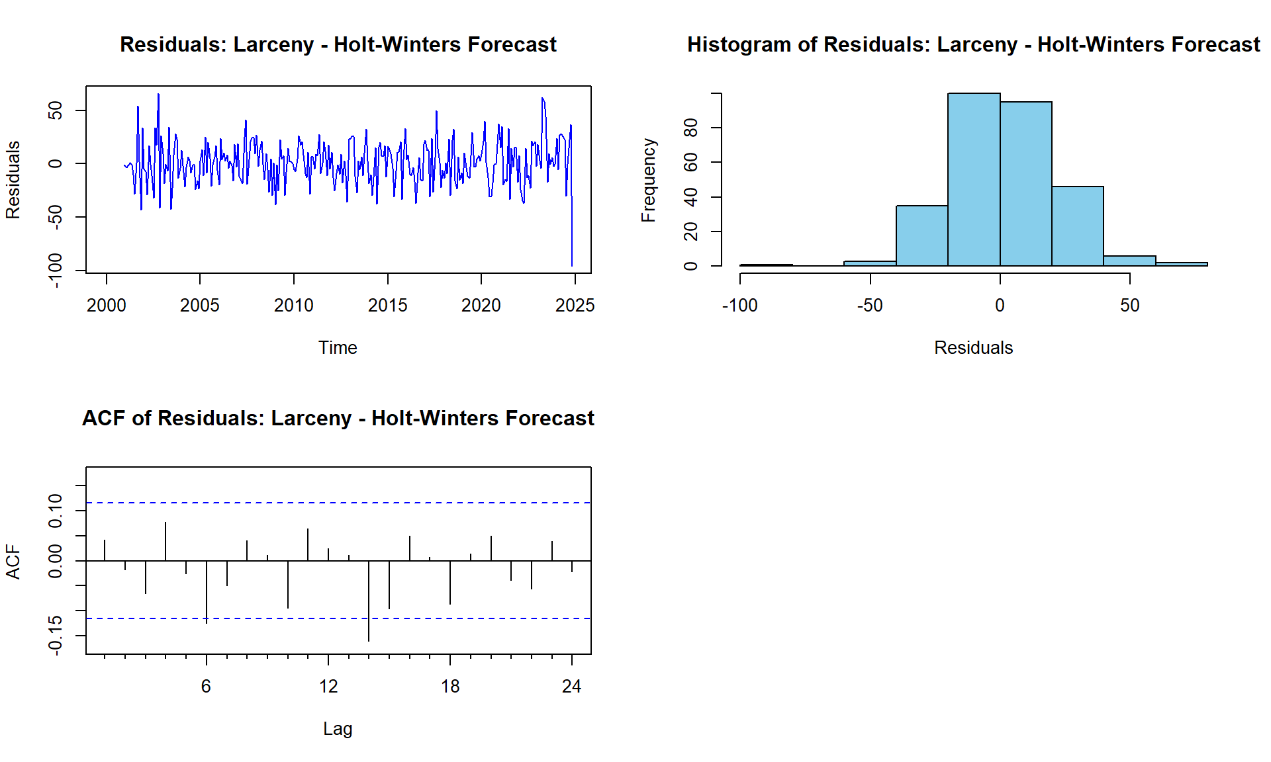
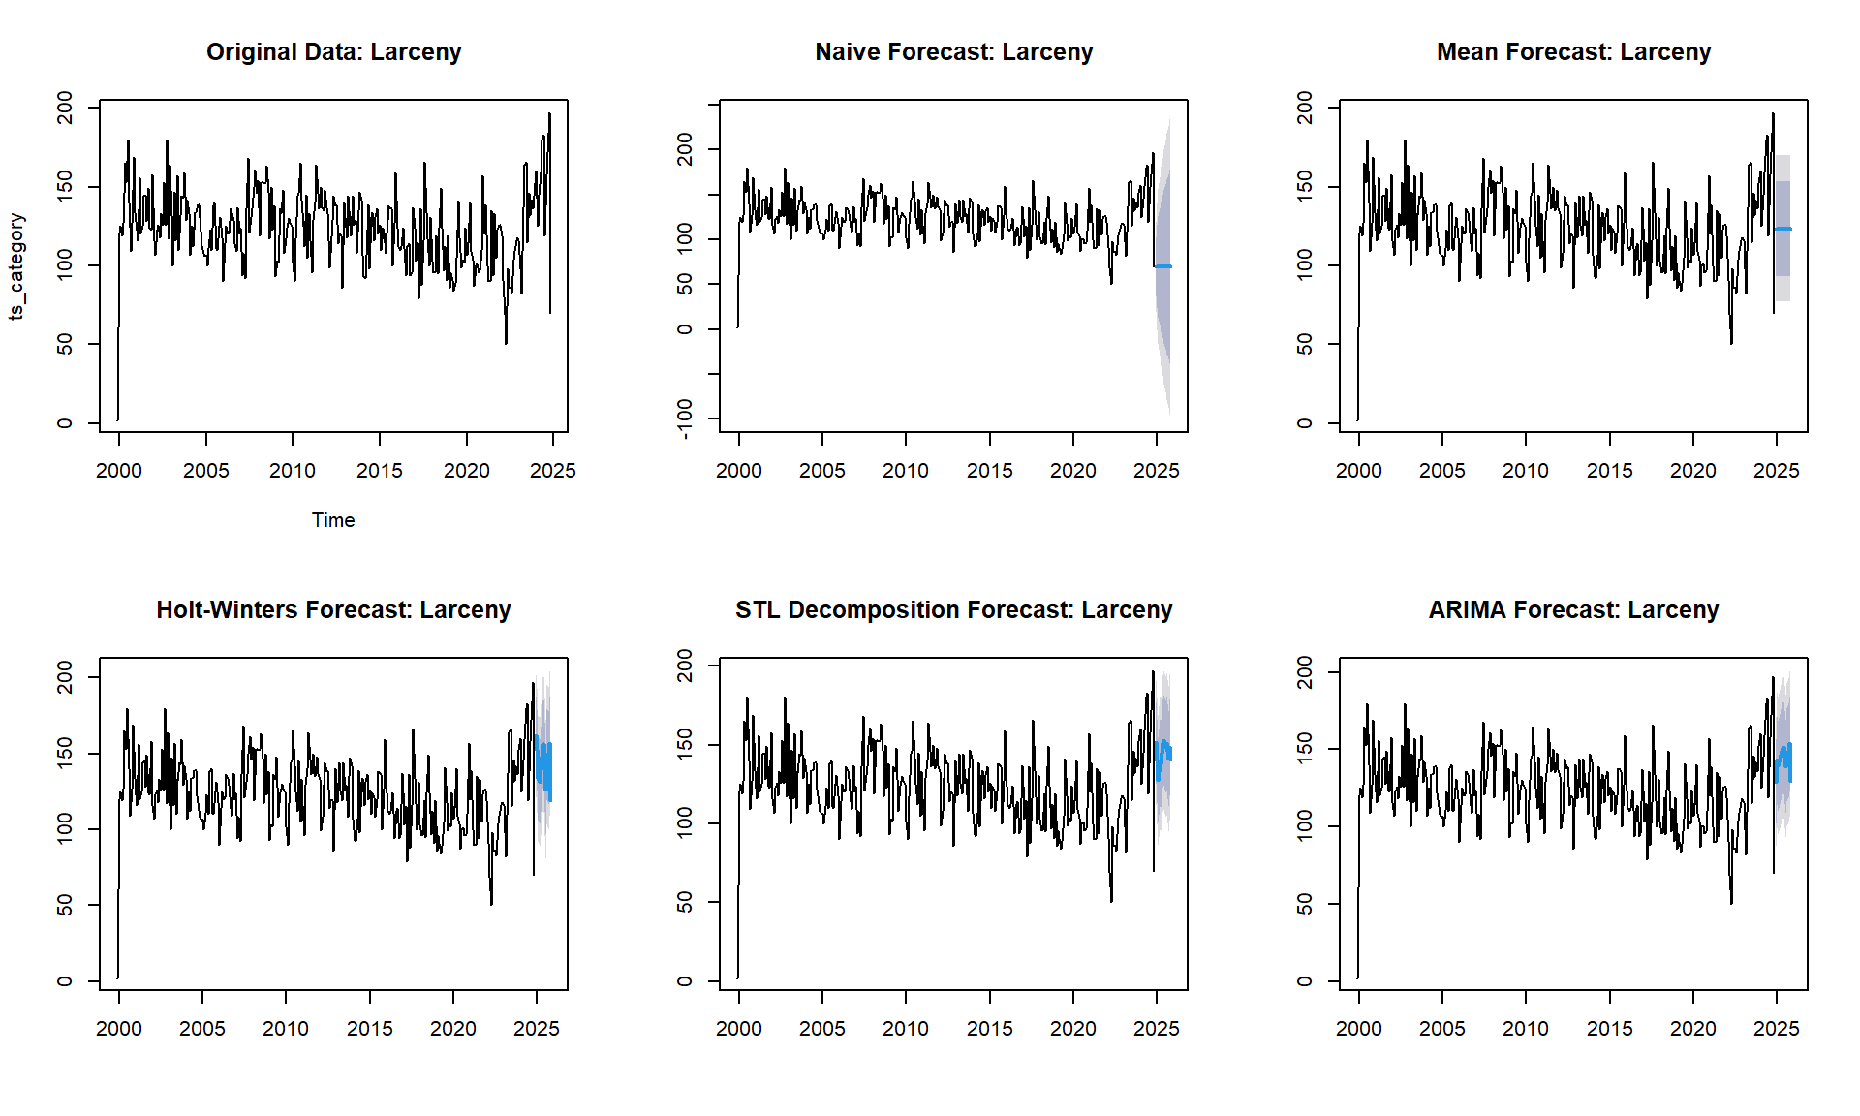
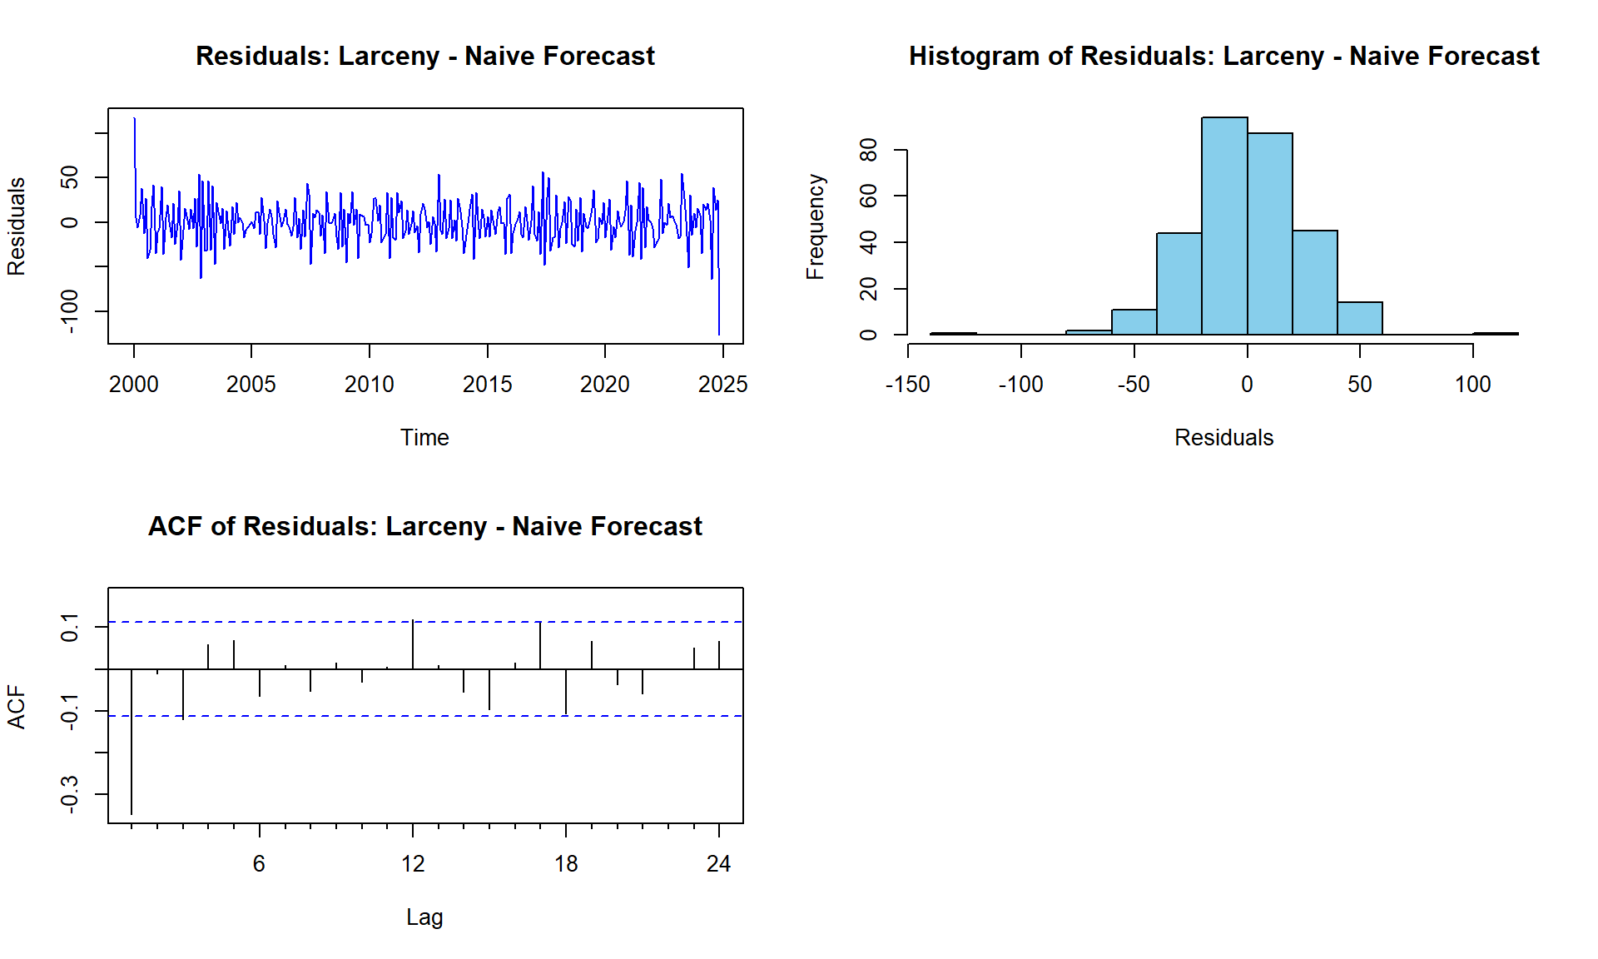
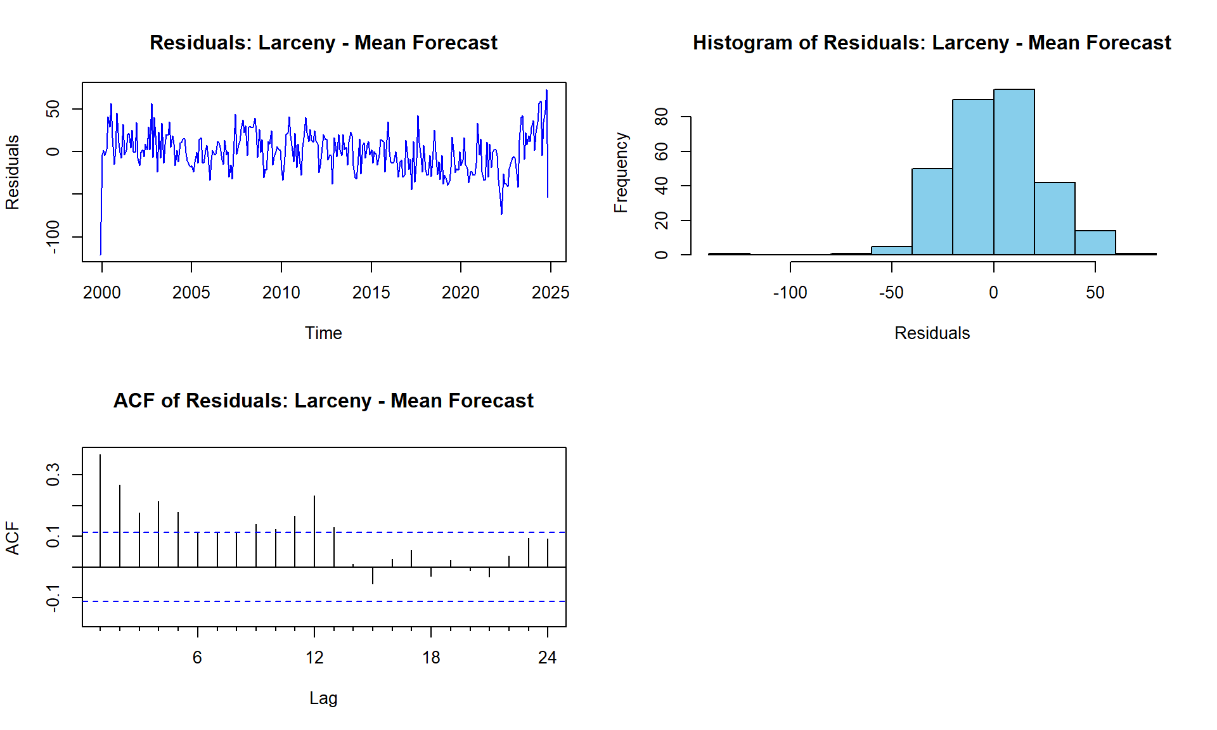
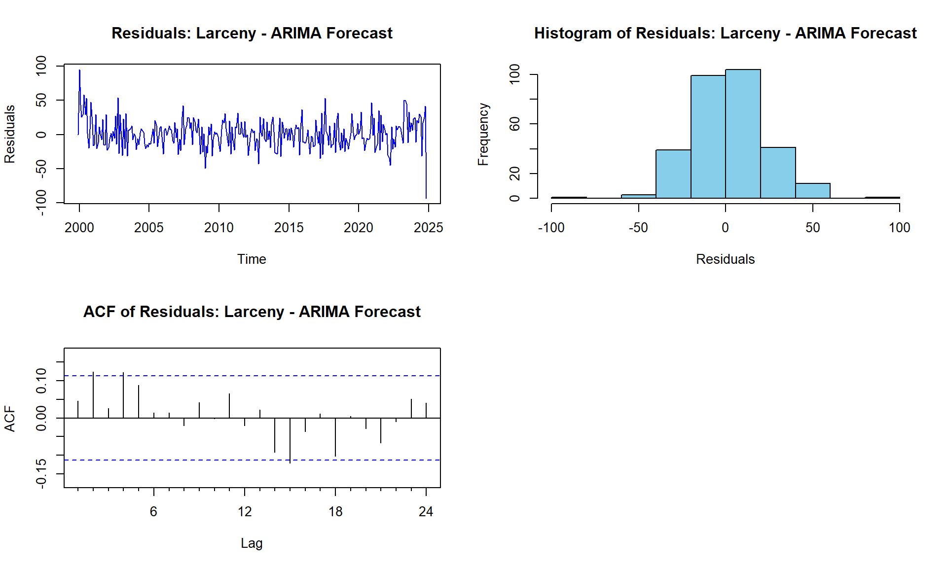
Larceny

Slide 25
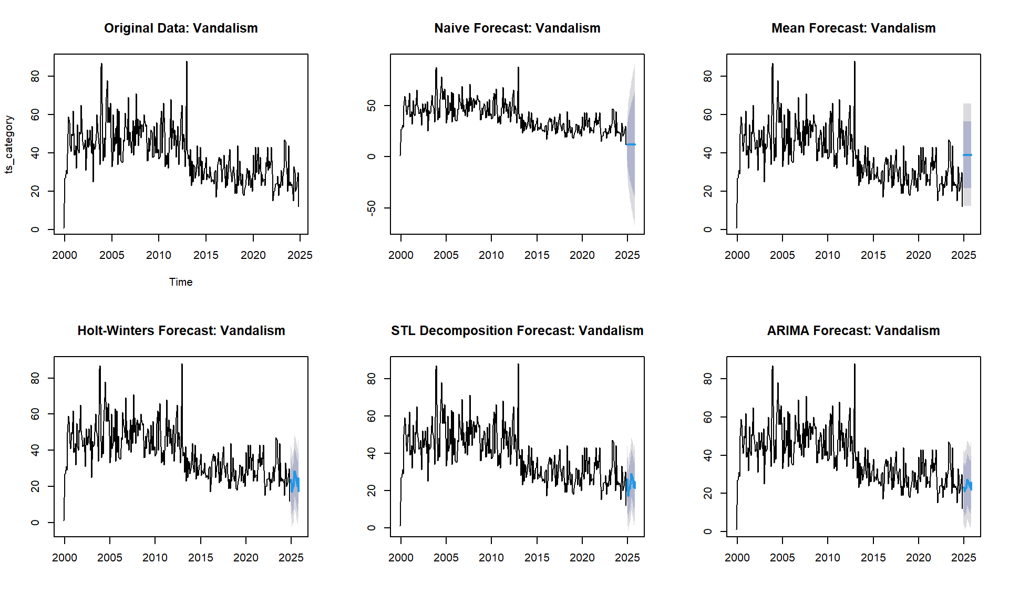
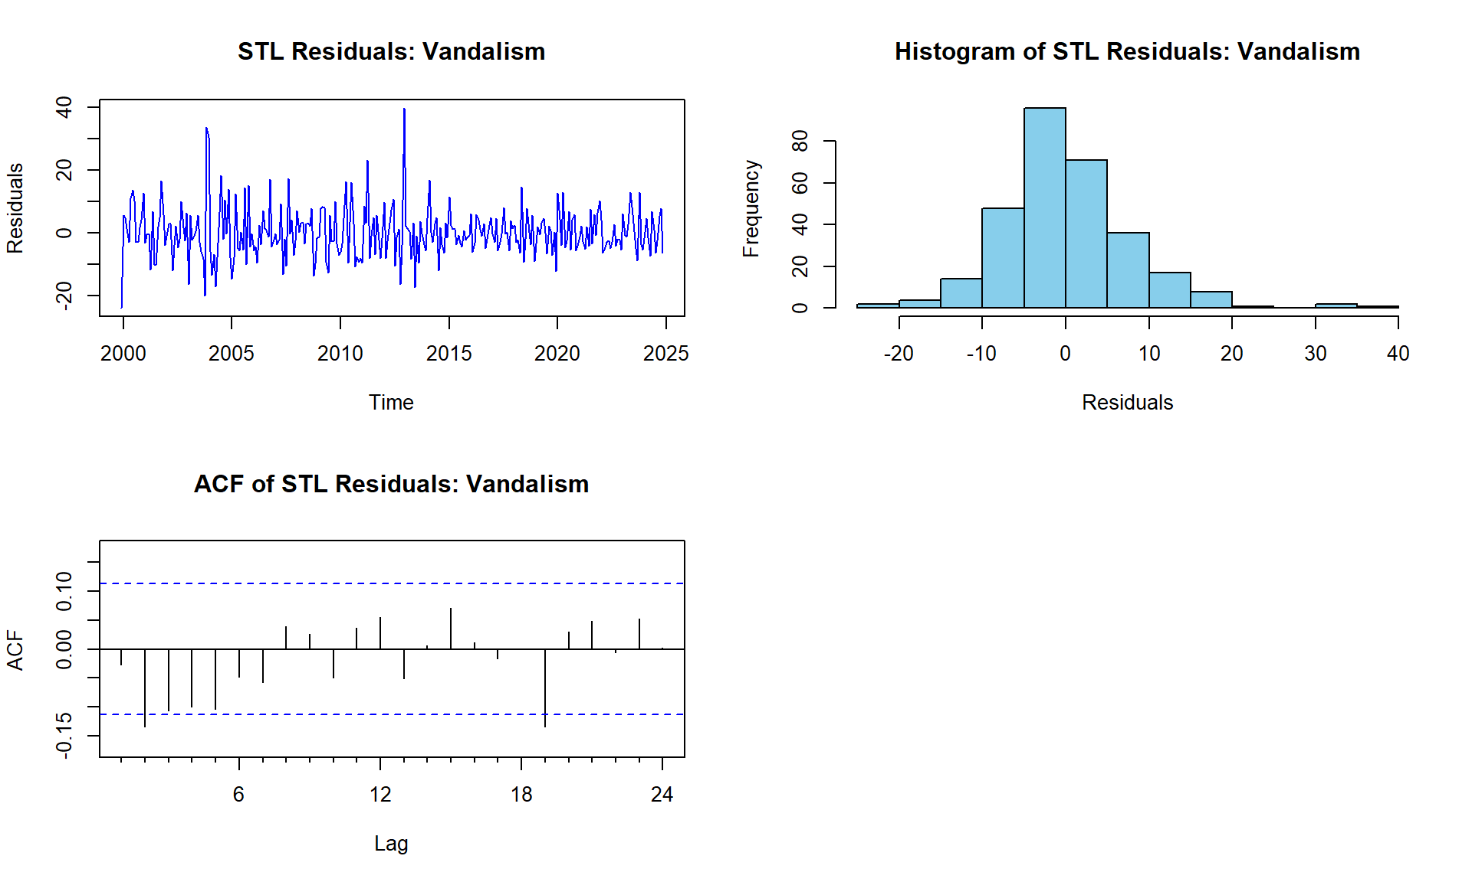




Vandalism

Slide 26





Foregery

Slide 27
Based on the individual forecasts for various crime categories, the analysis reveals distinct trends. Larceny, forgery, drugs, missing person, motor vehicle theft, and stolen property initially show a decrease, with stolen property subsequently increasing.
Vandalism, burglary, fraud, weapons offenses, and suicide are projected to rise, albeit at varying rates. Simple assault, alcohol-related offenses, DUI, aggravated assault, arson, embezzlement, and other offenses are expected to remain stable, with minor fluctuations in some cases.
Traffic violations, excluding DWI, are predicted to either decline slightly or remain steady.
These insights provide a nuanced understanding of potential future trends in crime rates across different categories.

Slide 28

Regression

Slide 29
Since the dataset has a lot of categorical data, regression might not be a best strategy, however the linear regression model predicts the longitude (Lon) based on the latitude (Lat) of crime incidents.
The scatter plot visualizes the relationship between Lat and Lon, with the regression line (in red) showing the best fit.
The summary of the regression model includes coefficients, their significance, and overall model metrics, providing insights into the spatial distribution of crimes.

Slide 30
Conclusion
The analysis and forecasting of crime data in Cary, NC, provide critical insights into crime trends and their spatial and temporal patterns.
By leveraging advanced time series methods such as ARIMA, Holt-Winters, and STL decomposition, the project identified distinct trends across various crime categories, enabling accurate predictions and highlighting areas requiring focused attention.
The results emphasize the effectiveness of models like STL decomposition and Moving Average in capturing trends and seasonality, while regression analysis offered a spatial perspective of crime incidents. The forecasts indicate stabilization in overall crime rates, with variations in specific categories like larceny, vandalism, and burglary.
These findings support data-driven decision-making for law enforcement, policymakers, and community stakeholders, facilitating resource optimization and targeted preventive measures to enhance public safety and community well-being.

